Slide 1
人工智能原理
第2章 搜索

Slide 2
Why search
Successful
Many other AI problems can be successfully solved by search
Outperform humans in some areas (e.g. games)
Practical
Many problems don't have specific algorithms for solving them. Casting as search problems is often the easiest way of solving them.
Search can also be useful in approximation (e.g., local search in optimization problems).
Problem specific heuristics provides search with a way of exploiting extra knowledge.
Some critical aspects of “intelligent” behavior, e.g., planning, can be cast as search.

Slide 3
Problem formulation
To formulate a problem as a search problem we need the following components:
1.a state space over which to search. The state space necessarily involves abstracting the real problem.
2.an initial state that best represents your current state.
3.a desired (or goal) condition you want to achieve.
4.actions (or successor functions) that allow move one from state to state. The actions are abstractions of actions you could actually perform.
Optional ingredients:
1.costs, which represent the cost of moving from state to state (taking an action, advancing to a successor state).
2. Heuristics, to help guide the search process.
Notes:
状态空间、起始态、终止态（目标态）、动作集
可选项：花费、启发规则

Slide 4
Problem solution
Once you have a formalized search problem, there are a number of algorithms one can use to solve it.
A solution is a sequence of actions or moves that can transform your current state into a state where desired (or goal) conditions hold.

Slide 5
Example 1: Romania Travel

Slide 6
Example 1
States: the various cities you could be located in.
Actions: drive between neighboring cities.
Initial state: in Arad
Goal: in Bucharest
Solution: the route, the sequence of cities to travel through to get to Bucharest.

Slide 7
Example 2: The 8-Puzzle
Rule: Can slide a tile into the blank spot. (Equivalently, can think of it as moving the blank around).

Slide 8
Example 3-Search Space for 8‐Puzzle Problem

Slide 9
Example 2
States: The different configurations of the tiles. How many different states?
Actions: Moving the blank up, down, left, right. Can every action be performed in every state?
Initial state: “start state” shown on the previous slide.
Goal: be in the goal state shown on the previous slide.
Solution: a sequence of moves that transform the initial state to a goal state.

Slide 10
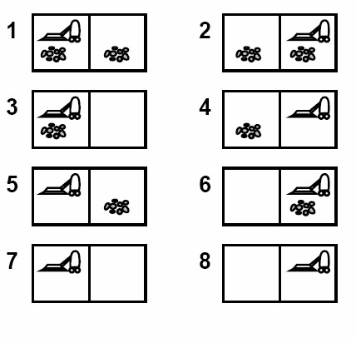
Example 3: Vacuum world
We have a vacuum cleaner and two rooms.
Each room may or may not be dirty.
The vacuum cleaner can move left or right (the action has no effect if there is no room to the right/left).
The vacuum cleaner can suck; this cleans the room (even if the room was already clean).
Physical states

Slide 11
Example 3: Vacuum world
Knowledge-level State Space
The state space can consist of a set of states. The agent knows that it is in one of these states, but doesn’t know which.
Goal is to have all rooms clean.

Slide 12
Example 3: Vacuum world
Knowledge-level State Space.
No knowledge of the world. States consist of sets of physical states.
Start in {1,2,3,4,5,6,7,8}, agent doesn’t have any knowledge of where it is.
Nevertheless, the actions <right, suck, left, suck> achieves the goal.
Goal is to have all rooms clean.
right {2,4,6,8} suck {4,8} left {3,7} suck {7}

Slide 13
Example 4: Water Jugs
We have a 3 gallon (liter) jug and a 4 gallon jug. We can fill either jug to the top from a tap, we can empty either jug, or we can pour one jug into the other (at least until the other jug is full).

Slide 14
Example 4
state space: pairs of numbers (gal3, gal4) where gal3 is the number of gallons in the 3 gallon jug, and gal4 is the number of gallons in the 4 gallon jug.
actions (successor functions): Empty-3-Gallon, Empty-4-Gallon, Fill-3-Gallon, Fill-4-Gallon, Pour-3-into-4, Pour 4-into-3.
initial state: Various, e.g., (0,0)
desired (or goal) condition: Various, e.g., (0,2) or (*, 3) where * means we don't care

Slide 15
Algorithms for search
Inputs:
a specified initial state (a specific world state or a set of world states representing the agent’s knowledge, etc.)
a successor function S(x) = {set of states that can be reached from state x via a single action}.
a goal test: to test a successor function that can be applied to a state and return true if the state satisfies the goal condition.
A step cost function C(x,a,y) which determines the cost of moving from state x to state y using action a. (C(x,a,y) =infinity if a does not yield y from x)
Output:
a sequence of states leading from the initial state to a state satisfying the goal test.

Slide 16
Obtaining the action sequence
The set of successors of a state x might arise from different actions, e.g.,
x → a → y
x → b → z
Successor function S(x) yields a set of states that can be reached from x via a (any) single action.
Rather than just return a set of states, we might annotate these states by the action used to obtain them:
S(x) = {<y,a>, <z,b>} y via action a, z via action b.
S(x) = {<y,a>, <y,b>} y via action a, also y via alternative action b.

Slide 17
Tree Search
Frontier is the set of states we haven't yet explored/expanded, and want to explore
Initial call has Frontier = the set of initial state
TreeSearch(Frontier, Sucessors, Goal? ) If Frontier is empty return failure Curr = select state from Frontier If (Goal==(Curr)) return Curr. Frontier’ = (Frontier – {Curr}) U Successors(Curr) return TreeSearch(Frontier’, Successors, Goal?)

Slide 18
Example1: Romania travel
{Arad},
{Z<A>, T<A>, S<A>},
{Z<A>, T<A>, A<S;A>, O<S;A>, F<S;A>, R<S;A>}
{Z<A>, T<A>, A<S;A>, O<S;A>, R<S;A>, S<F;S;A>, B<F;S;A>}
Solution: Arad -> Sibiu -> Fagaras -> Bucharest
Cost: 140 + 99 + 211 = 450
Notes:
演示算法-1

Slide 19
Another Solution
{Arad},
{Z<A>, T<A>, S<A>},
{Z<A>, T<A>, A<S,A>, O<S,A>, F<S,A>, R<S,A>}
{Z<A>, T<A>, A<S,A>, O<S,A>, F<S,A>, S<R,S,A>, P<R,S,A>, C<R,S,A>}
{Z<A>, T<A>, A<S,A>, O<S,A>, F<S,A>, S<R,S,A>, C<R,S,A>, R<P,R,S,A>, C<P,R,S,A>, Bucharest<P,R,S,A>}
Solution: Arad -> Sibiu -> Rimnicu Vilcea -> Pitesti -> Bucharest
Cost: 140 + 80 + 97 + 101 = 418

Slide 20
The Cycle Issue
{Arad}
{Z<A>, T<A>, S<A>},
{Z<A>, T<A>, O<S;A>, F<S;A>, A<S;A>, R<S;A>}
{Z<A>, T<A>, O<S;A>, F<S;A>, R<S;A>, Z<A;S;A>, T<A;S;A>, S<A,S,A>}
Frontier is a set of paths not a set of states: cycles become an issue.

Slide 21
Selection Rule
The example shows that the order states are selected from the frontier has a critical effect on the operation of the search:
Whether or not a solution is found
The cost of the solution found
The time and space required by the search

Slide 22
Search tree

Slide 23
Example 4-水壶问题
给定两个水壶A,B，A可装4加仑水，B能装3加仑水。水壶上没有任何度量标记。有一水泵可用来往壶中装水。
问：怎样在能装4加仑的水壶里恰好只装2加仑水？

Slide 24
Water jug search algorithm
（1）定义状态空间
可将问题进行抽象，用数偶(x,y)表示状态空间的任一状态。
x—表示4gallon水壶中所装的水量，x=0，1，2，3或4；
y—表示3gallon水壶中所装的水量，y=0，1，2或3；

Slide 25
初始状态为 (0,0)
目标状态为 (2,?)
？表示水量不限，因为问题中未规定在3加仑水壶里装多少水。

Slide 26
（2）确定一组操作
1（X，Y|X<4）→（4，Y） 4加仑水壶不满时，将其装满；
2（X，Y|Y<3）→（X，3） 3加仑水壶不满时，将其装满；
3（X，Y|X>0）→（0，Y） 把4加仑水壶中的水全部倒出；

Slide 27
4（X，Y|Y>0）→（X，0）
把3加仑水壶中的水全部倒出；
5（X，Y|X+Y≥4∧Y>0） → （4，Y-（4-X））
把3加仑水壶中的水往4加仑水壶里倒，直至4加仑水壶装满为止
6（X，Y|X+Y≥3∧X>0）→ （X-（3-Y），3）
把4加仑水壶中的水往3加仑水壶里倒，直至3加仑水壶装满为止；
7 （X，Y|X+Y≤4∧Y>0）→（X+Y，0）
把3加仑水壶中的水全部倒进4加仑水壶里；
8（X，Y|X+Y≤3∧X>0）→ （0，X+Y）
把4加仑水壶中的水全部倒进3加仑水壶里；

Slide 28
（3）选择一种搜索策略
该策略为一个简单的循环控制结构：选择其左部匹配当前状态的某条规则，并按照该规则右部的行为对此状态作适当改变，然后检查改变后的状态是否为某一目标状态，若不是，则继续该循环。

Slide 29
4加仑水壶中 3加仑水壶中 所应用的
含水加仑数 含水加仑数 规则
0 0
0 3 2
3 0 7
3 3 2
4 2 5
0 2 3
2 0 7
Notes:
演示算法-2

Slide 30
Critical Properties of Search
Completeness: will the search always nd a solution if a solution exists?
Optimality: will the search always nd the least cost solution? (when actions have costs)
Time complexity: what is the maximum number of nodes than can be expanded or generated?
Space complexity: what is the maximum number of nodes that have to be stored in memory?

Slide 31
Uninformed Search Strategies
These are strategies that adopt a fixed rule for selecting the next state to be expanded.
The rule does not change irrespective of the search problem being solved.
These strategies do not take into account any domain specific information about the particular search problem.

Slide 32
Popular Uninformed Search Techniques
Breadth-First
Uniform-Cost
Depth-First
Depth-Limited
Iterative-Deepening search

Slide 33
Selecting vs. Sorting
A simple uniform method need exploit the order of the elements on the frontier.
Always select the first element.
Any selection rule can be achieved by employing an appropriate ordering of the frontier set.
Notes:
选择顶点Frontier Selection can be achieved by employing an appropriate
ordering of the frontier set, i.e.: 1. Order the elements on the Frontier.
2. Always select the first element.

Slide 34
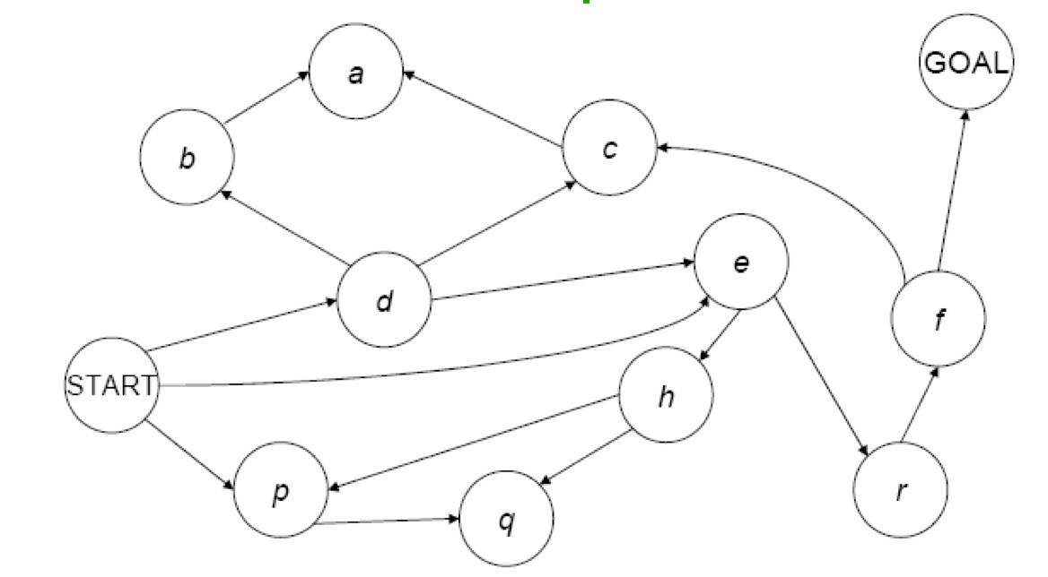
Breadth First Search
1. Place Start in the Frontier.
2. Expand all nodes reachable from Start in 1 step, but not more than 1; add path to back of Frontier list.
3. Expand all nodes reachable from Start in 2 step, but not more than 2; add path to back of Frontier list.
4. Expand all nodes reachable from Start in 3 step, but not more than 3; add to path back of Frontier list.
5. And so on ….

Slide 41
BFS for the Water Jug Problem
initial state = (0,0), goal state = (*,2), actions (successor functions): Empty-3-Gallon, Empty-4-Gallon, Fill-3-Gallon, Fill-4-Gallon, Pour-3-into-4, Pour 4-into-3.
1.Frontier = {<(0,0)>}
store complete paths on the frontier.
Notes:
算法演示-2

Slide 42
BFS for the Water Jug Problem
initial state = (0,0), goal state = (*,2), actions (successor functions): Empty-3-Gallon, Empty-4-Gallon, Fill-3-Gallon, Fill-4-Gallon, Pour-3-into-4, Pour 4-into-3.
1.Frontier = {<(0,0)>}
2.Frontier = {<(0,0),(3,0)>, <(0,0),(0,4)>}
store complete paths on the frontier.
Notes:
算法演示-2

Slide 43
BFS for the Water Jug Problem
initial state = (0,0), goal state = (*,2), actions (successor functions): Empty-3-Gallon, Empty-4-Gallon, Fill-3-Gallon, Fill-4-Gallon, Pour-3-into-4, Pour 4-into-3.
1.Frontier = {<(0,0)>}
2.Frontier = {<(0,0),(3,0)>, <(0,0),(0,4)>}
3.Frontier = {<(0,0),(0,4)>, <(0,0),(3,0),(0,0)>,
<(0,0) ,(3,0),(3,4)>, <(0,0),(3,0),(0,3)>
store complete paths on the frontier.
Notes:
算法演示-2

Slide 44
BFS for the Water Jug Problem
initial state = (0,0), goal state = (*,2), actions (successor functions): Empty-3-Gallon, Empty-4-Gallon, Fill-3-Gallon, Fill-4-Gallon, Pour-3-into-4, Pour 4-into-3.
1.Frontier = {<(0,0)>}
2.Frontier = {<(0,0),(3,0)>, <(0,0),(0,4)>}
3.Frontier = {<(0,0),(0,4)>, <(0,0),(3,0),(0,0)>,
<(0,0) ,(3,0),(3,4)>, <(0,0),(3,0),(0,3)>
4.Frontier = {<(0,0),(3,0),(0,0)>, <(0,0),(3,0),(3,4)>,
<(0,0),(3,0),(0,3)>, <(0,0),(0,4),(0,0)>, <(0,0),(0,4),(3,4)>, <(0,0),(0,4),(3,1)>}
store complete paths on the frontier.
Notes:
算法演示-2

Slide 45
BFS for the Water Jug Problem
In the tree above we order the states explored; paths to states are
represented by the path from the root to that states.
Breadth‐First Search explores the search space level by level.
Notes:
算法演示-2

Slide 46
Breadth‐First Properties
The tree representation enables us to measure time and space complexity.
let b be the maximum number of successors of any node (i.e. the maximal branching factor).
let d be the depth of the shortest solution.
Root at depth 0 generates a path of length 1
So d = length of path ‐ 1
What is the Time Complexity?

Slide 47
Breadth‐First Properties
The tree representation enables us to measure time and space complexity.
let b be the maximum number of successors of any node (i.e. the maximal branching factor).
let d be the depth of the shortest solution.
Root at depth 0 generates a path of length 1
So d = length of path ‐ 1
What is the Time Complexity?
1 + b + b^2 + b^3 + … + b^d-1 + b^d + b(b^d – 1) = O(b^(d+1))

Slide 48
Breadth‐First Properties
Space Complexity?
O(b^{d+1}) : If goal node is last node at level d, all of the successors of the other nodes will be on the Frontier when the goal node is expanded b(b^{d} – 1)
Optimality?
We will find the shortest length solution. Is this the least cost solution?
Completeness?
Eventually we must examine all paths of length d, and thus we will find a solution if one exists.

Slide 49
Real Problem of BFS: Space Complexity
E.g., let b = 10, and say 100,000 nodes can be expanded per second and each node requires 100 bytes of storage:
Depth | Nodes | Time | Memory
1 | 1 | 0.01 millisec. | 100 bytes
6 | 10⁶ | 10 sec. | 100 MB
8 | 10⁸ | 17 mins. | 10 GB
9 | 10⁹ | 3 hrs. | 100 GB
Typically run out of space before we run out of time in most applications.
Notes:
Branch b = 10, 100,000 node can be expanded per second, the space requirements of different depths.
举例来说：结点分支平均10， 一个平均每秒可以扩展十万结点的搜索树，如果每个结点要求100字节的话，它在各层要求的空间如下表。比如10^6 * 100 B= 100MB

Slide 50
Depth‐First Search
Like BFS, but instead of at the back we place the new paths that extend the current path at the front of the Frontier.

Slide 51
Depth‐First Search
initial state = (0,0), goal state = (*,2), actions (successor functions) = Empty-3-Gallon, Empty-4-Gallon, Fill-3-Gallon, Fill-4-Gallon, Pour-3into-4, Pour 4-into-3.
Frontier = {<(0,0)>}
Frontier = {<(0,0), (3,0)>, <(0,0), (0,4)>}
Frontier = {<(0,0),(3,0),(0,0)>, <(0,0),(3,0),(3,4)>, <(0,0),(3,0),(0,3)>, <(0,4),(0,0)>}
Frontier = {<(0,0),(3,0),(0,0),(3,0)>, <(0,0),(3,0),(0,0),(0,4)> <(0,0), (3,0), (3,4)>, <(0,0),(3,0),(0,3)>, <(0,0),(0,4)>}

Slide 52


Depth‐First Search
Red nodes are backtrack points (these nodes remain on Frontier).

Slide 53
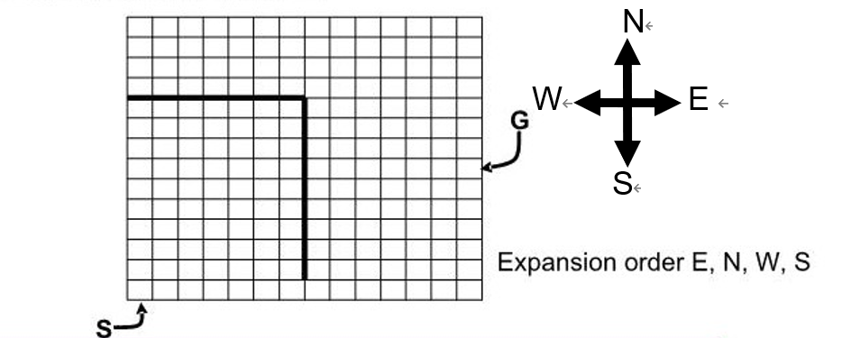
Maze Example
Imagine states are cells in a maze, you can move E, N, W, S. What would plain DFS do, assuming it always expanded the E successor first, then N,W,S
start
What would BFS do?

Slide 54
Depth‐First Properties
Complete?

Slide 55
Depth‐First Properties
Complete?
NO, if there are infinite paths
NO, if there are cycles in the graph
Prune paths with cycles (duplicate states)
YES, if state space is finite.
Optimal?

Slide 56
Depth‐First Properties
Complete?
NO, if there are infinite paths
NO, if there are cycles in the graph
Prune paths with cycles (duplicate states)
YES, if state space is finite.
Optimal?
NO

Slide 57
Depth‐First Properties
Time Complexity?
O(b^{m}) where m is the length of the longest path in the state space.
Very bad if m is much larger than d (shortest path to a goal state), but if there are many solution paths it can be much faster than breadth first (by good luck, can bump into a solution quickly).
Space Complexity?
O(bm), linear space!
Only explore a single path at a time.
Frontier only contains the deepest node on the current path along with the backtrack points (references to unexplored siblings of states).
A significant advantage of DFS

Slide 58
Depth Limited Search
Breadth first has space problems. Depth first can run off down a very long (or infinite) path.
Depth limited search
– Perform depth first search but only to a depth limit d.
• The ROOT is at DEPTH 0. ROOT is a path of length 1.
– No node representing a path of length more than d+1 is
placed on the Frontier.
– “Truncate” the search by looking only at paths of length
d+1 or less.
•Now infinite length paths are not a problem.
•But will only find a solution if a solution of DEPTH ≤ d exists.

Slide 59
Depth Limited Search
DLS (Frontier, Successors, Goal?) /* Call with Frontier = {<START>} */ WHILE (Frontier not EMPTY) { n= select first node from Frontier Curr = terminal state of n If(Goal?(Curr)) return n If Depth(n) < D //Don't add successors if Depth(n) = D!! Frontier= (Frontier– {n}) U Successors(Curr) Else Frontier= Frontier– {n} CutOffOccured = TRUE. } return FAIL

Slide 60
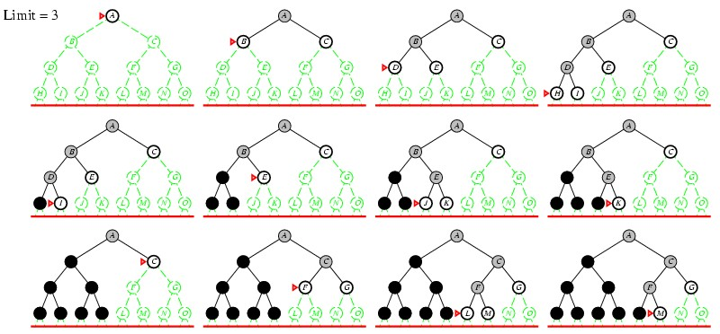
Depth Limited Search Example
Notes:
演示算法-3

Slide 61
Iterative Deepening Search
Solve the problems of depth-first and breadth-first by extending depth limited search.
Starting at depth limit L = 0, we iteratively increase the depth limit, performing a depth limited search for each depth limit.
Stop if a solution is found, or if the depth limited search failed without cutting off any nodes because of the depth limit.
If no nodes were cut off, the search examined all paths in the state space and found no solution → no solution exists.

Slide 62
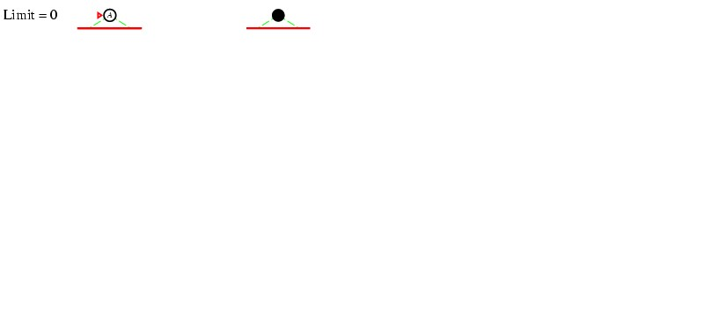
Iterative Deepening Search

Slide 63
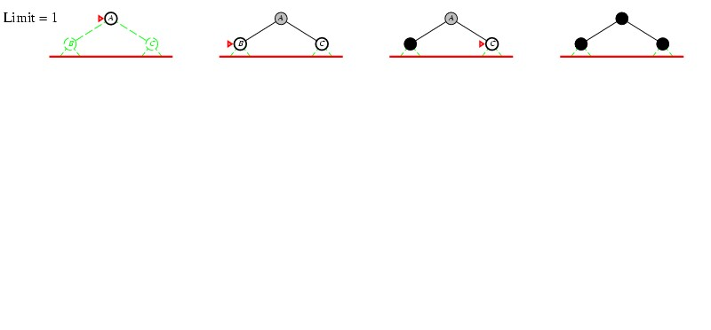
Iterative Deepening Search

Slide 64
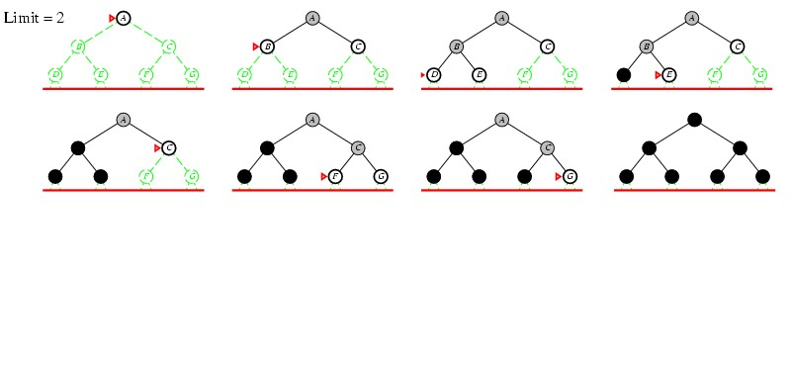
Iterative Deepening Search

Slide 65
Iterative Deepening Search

Slide 66
Iterative Deepening Search
Completeness?
YES, if a minimal depth solution of depth d exists.
What happens when the depth limit L=d?
What happens when the depth limit L<d?
Time Complexity?

Slide 67
Iterative Deepening Search (IDS)
Time Complexity?
(d+1)b⁰ + db¹ + (d-1)b² + … + b^{d} = O(b^{d}) –E.g. b=4, d=10
(11)*4⁰ + 10*4¹ + 9*4² + … + 4¹⁰ ⁼ 1,864,131
4¹⁰ = 1,048,576
Most nodes lie on bottom layer.

Slide 68
BFS can explore more states than IDS!
For IDS, the time complexity is
(d+1)b⁰ + db¹ + (d-1)b² + … + b^{d} = O(b^{d})
For BFS, the time complexity is
– 1 + b + b² + b³ + … + b^{d} + b(b^{d} – 1) = O(b^{d+1})
E.g. b=4, d=10
For IDS
(11)*4⁰ + 10*4¹ + 9*4² + … + 4¹⁰ ⁼ 1,864,131 (states generated)
For BFS
1 + 4 + 4² + … + 4¹⁰ + 4(4¹⁰ – 1) = 5,592,401 (states generated)

Slide 69
Path Checking
Recall that paths are commonly stored on the Frontier.
If n_{k} represents the path <s₀,s₁,…,s_{k}> and we expand s_{k} to obtain child c, we have <s₀,s₁,…,s_{k},c> as the path to “c”.
Path checking:
Ensure that the state c is not equal to the state reached by any ancestor of c along this path.
Paths are checked in isolation!

Slide 70
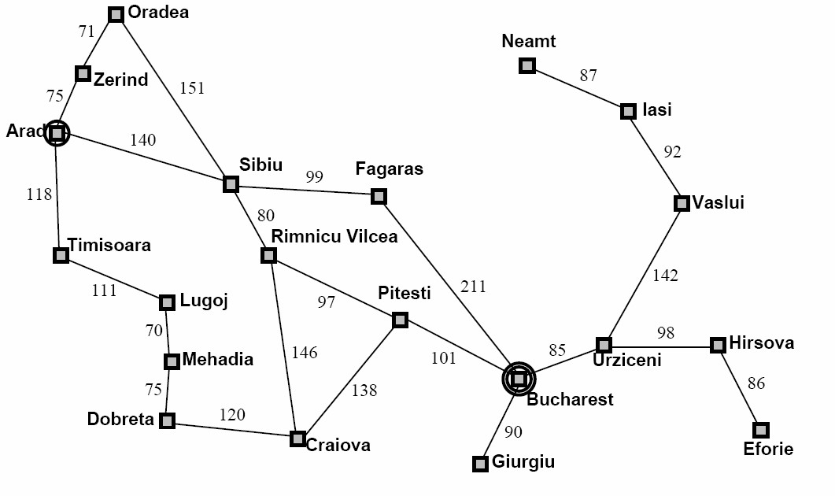
Example: Path Checking from Arad to Neamt

Slide 71
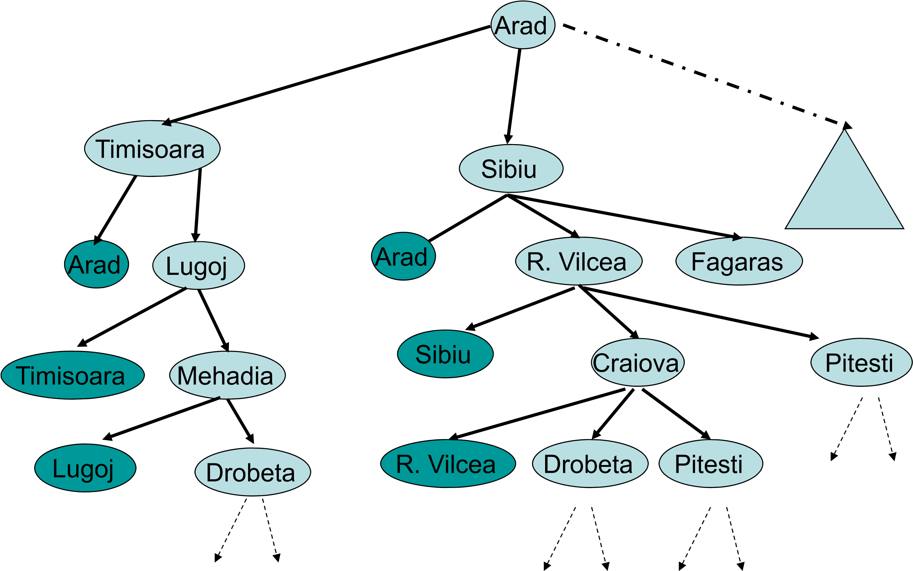
Path Checking Example
Dobreta

Slide 72
Cycle Checking
Keep track of all states previously expanded during the search.
When we expand n_{k} to obtain child c
Ensure that c is not equal to any previously expanded state.
This is called cycle checking, or multiple path checking.
What happens when we utilize this technique with depth-first search?
What happens to space complexity?

Slide 73
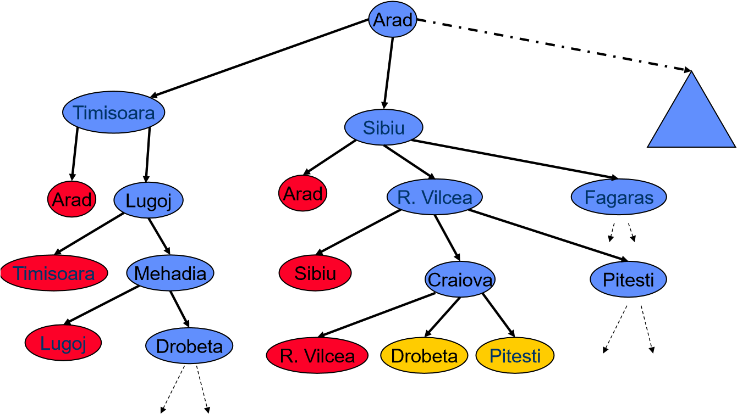
Cycle Checking Example (BFS)
Drobeta

Slide 74
Cycle Checking
Higher space complexity (equal to the space complexity of breadth-first search).
Other issues with cycle checking will come up when we look at heuristic search.

Slide 75
Uniform‐Cost Search
Keeps Frontier ordered by increasing cost of the path (know a good data structure for this?)
Always expand the least cost path.
Identical to Breadth First Search if each action has the same cost
Notes:
演示算法-4

Slide 76
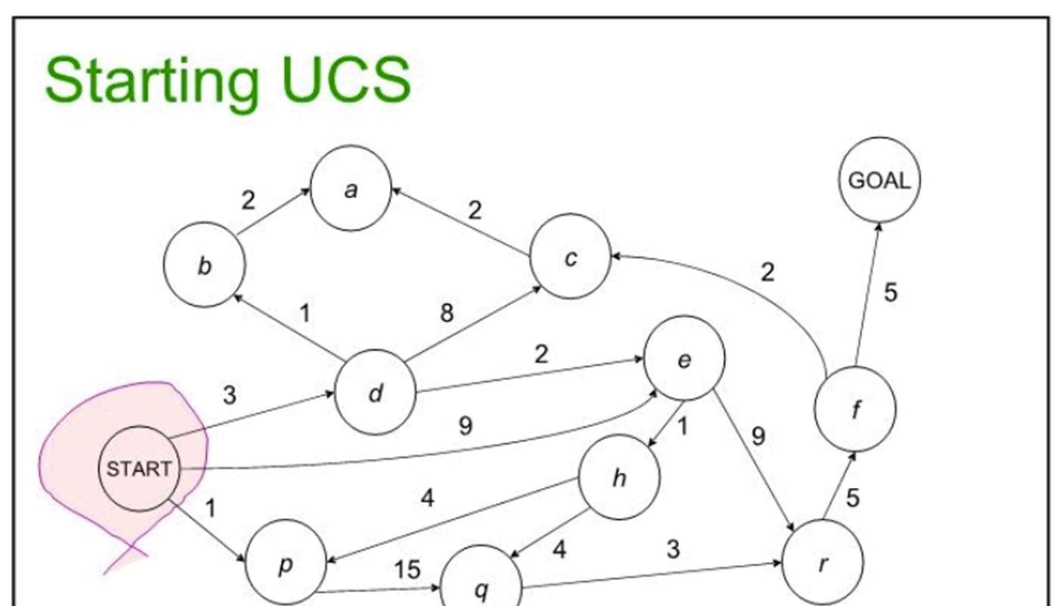


Slide 77
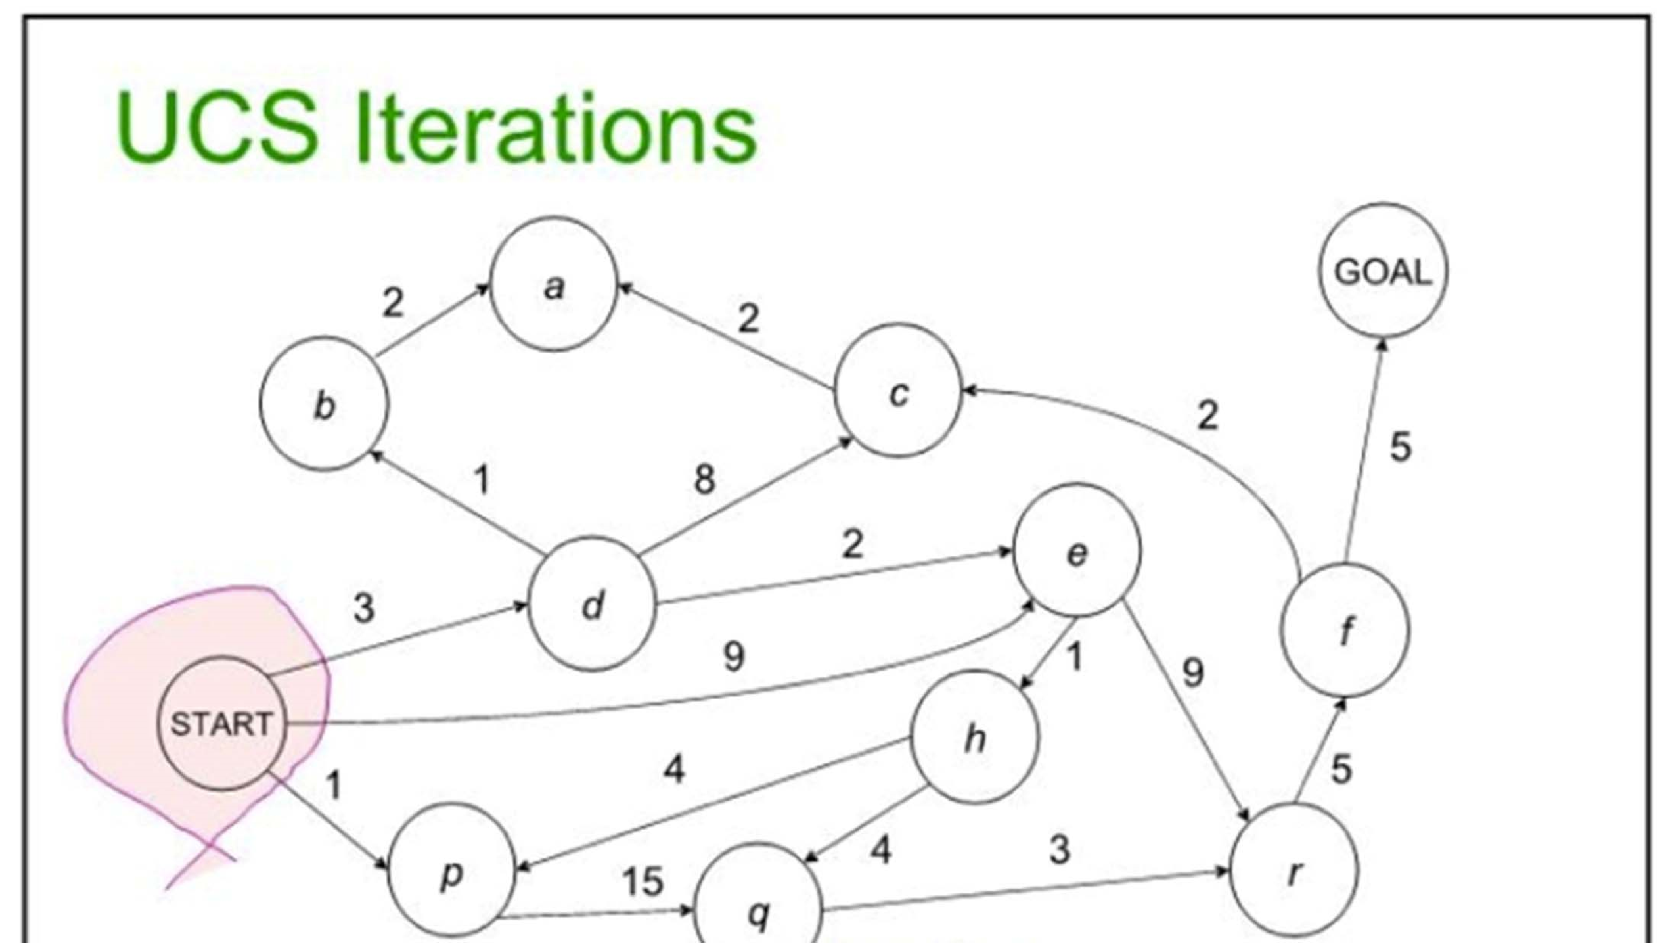
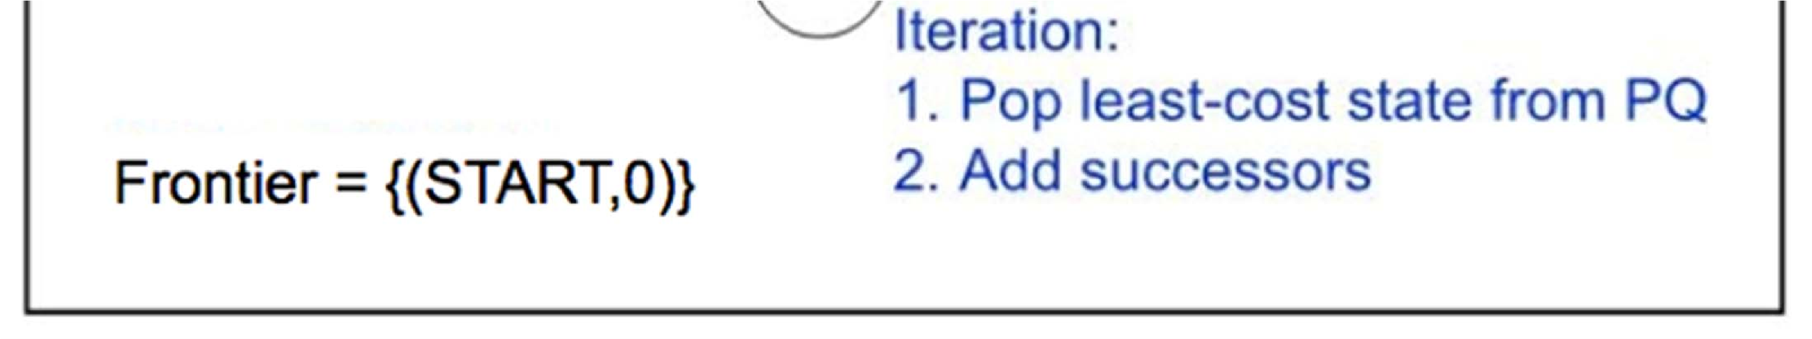

Slide 78
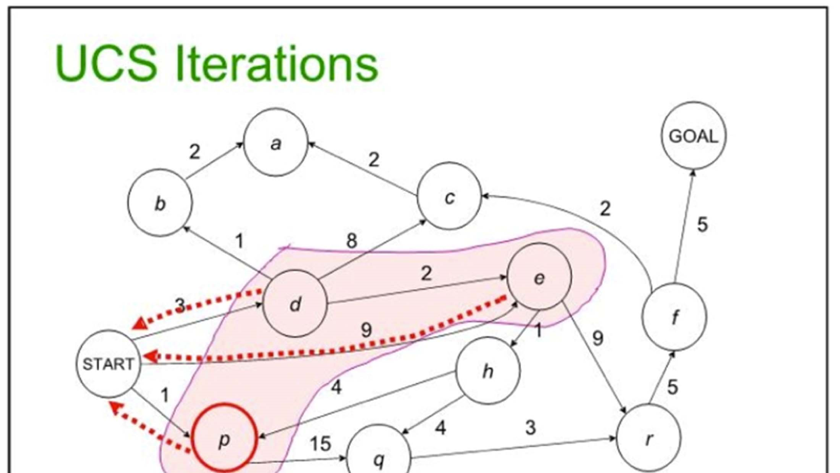
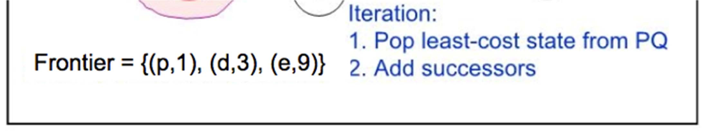

Slide 79
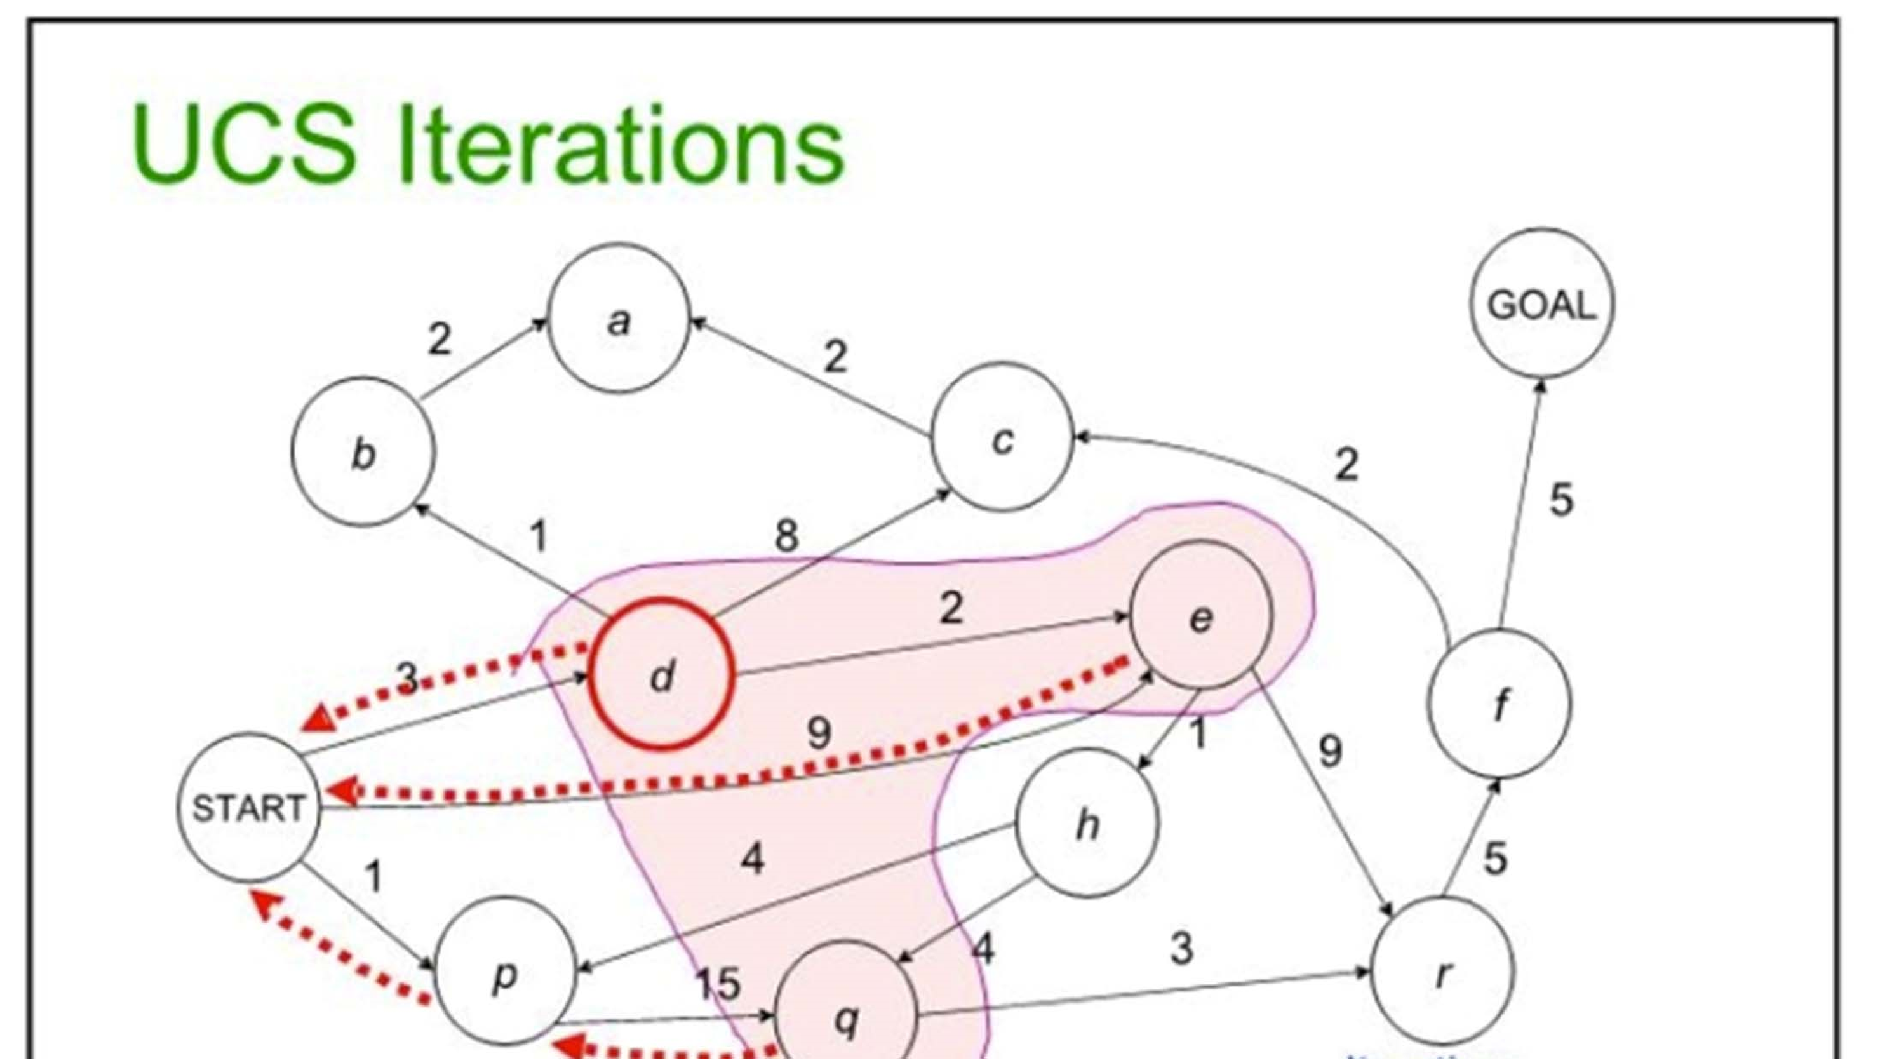
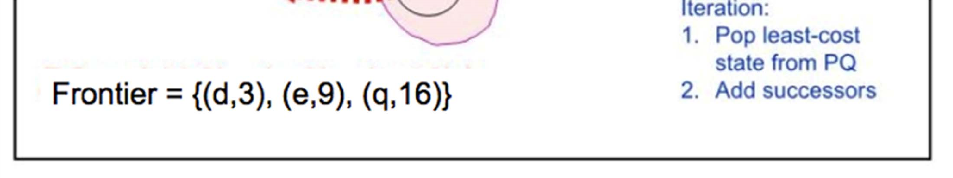

Slide 80
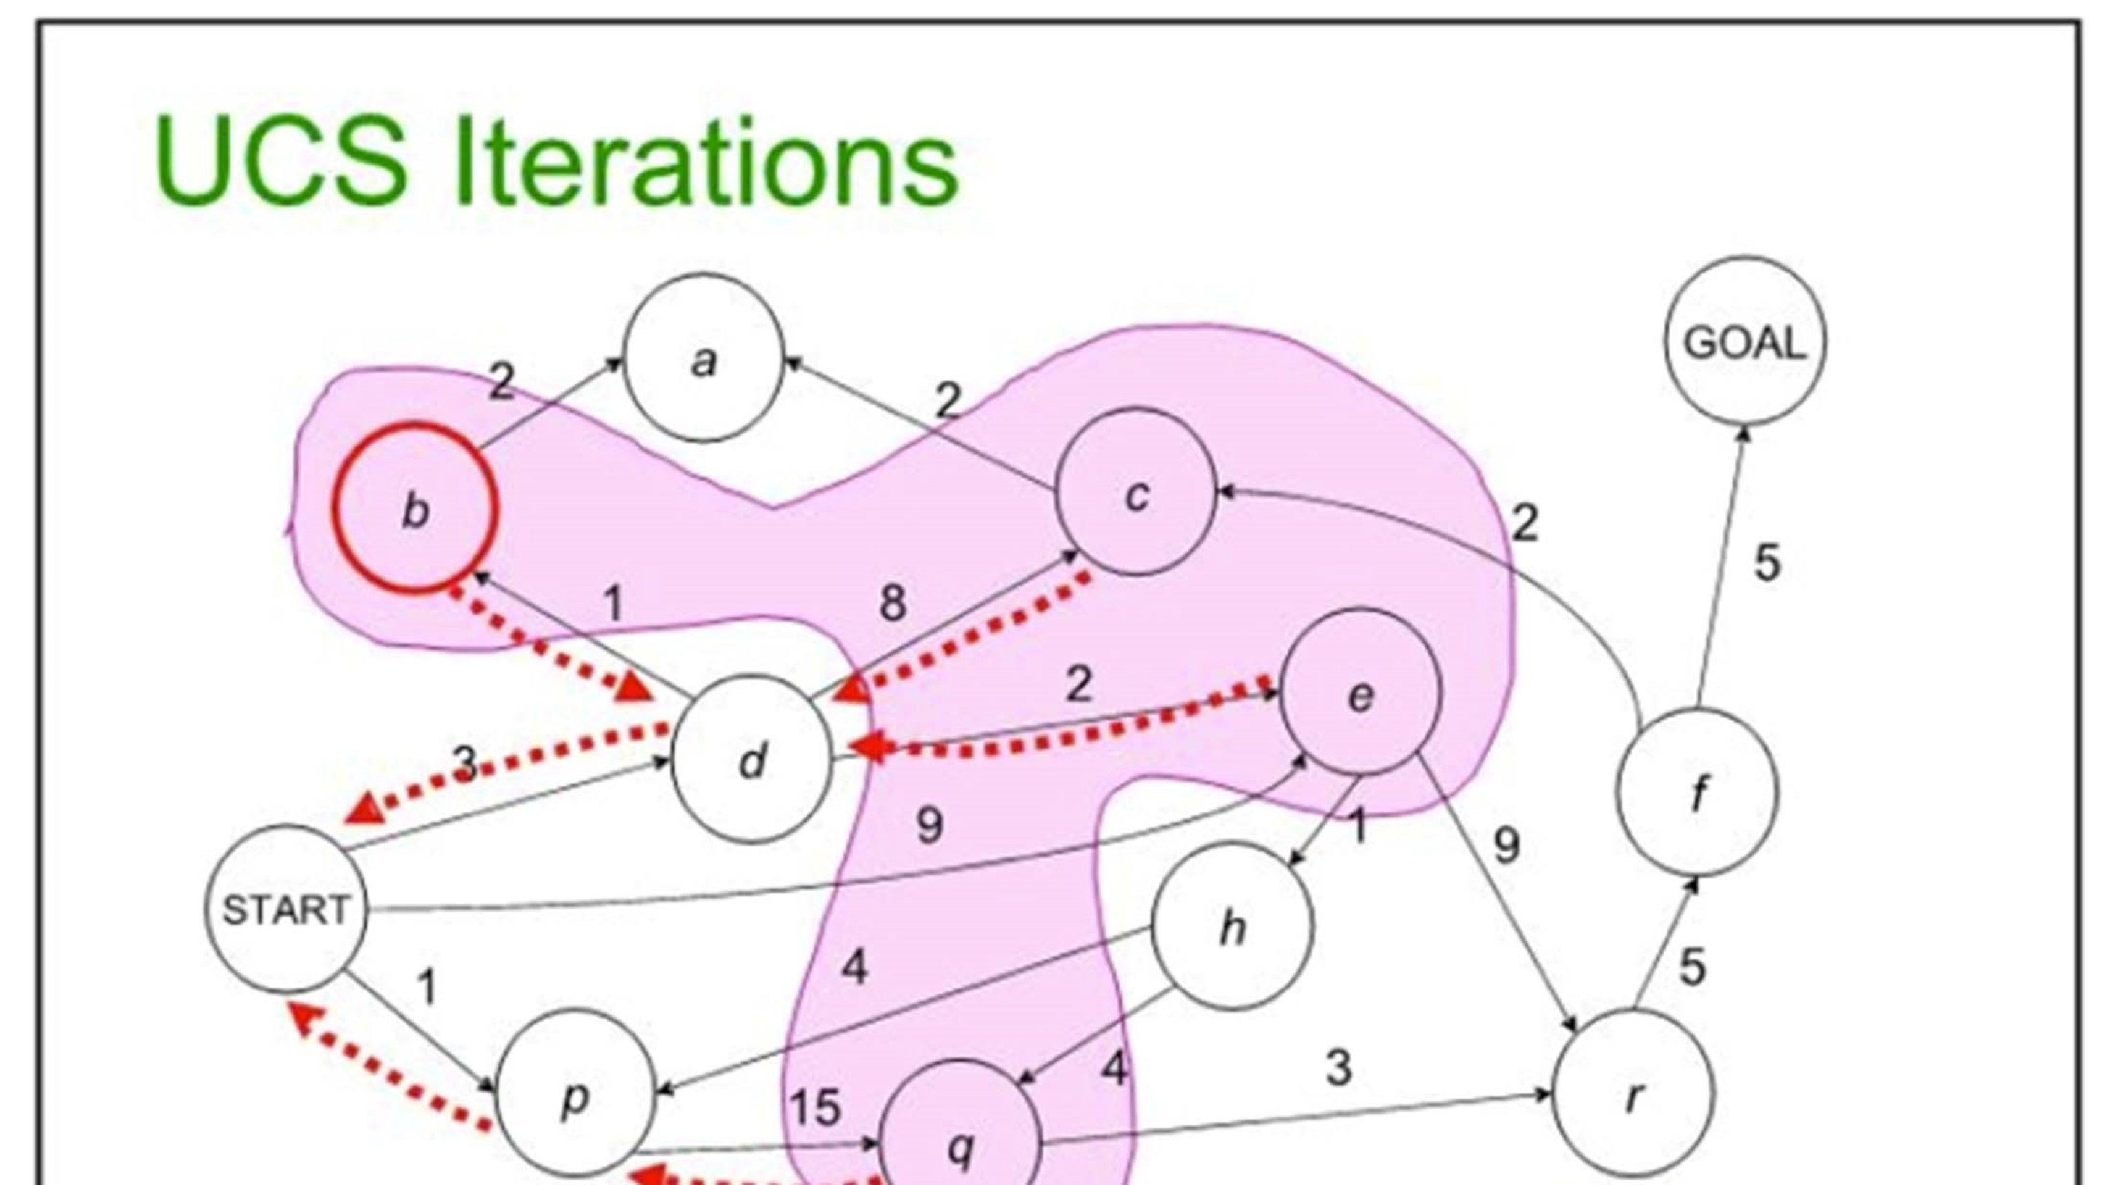
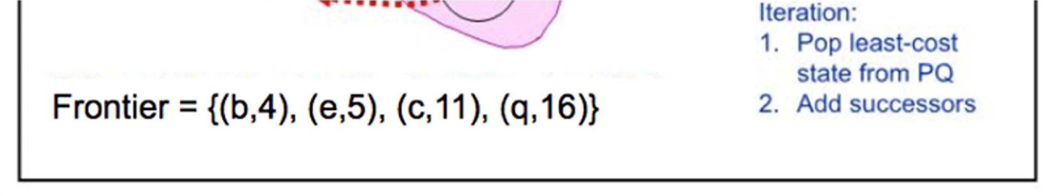

Slide 81
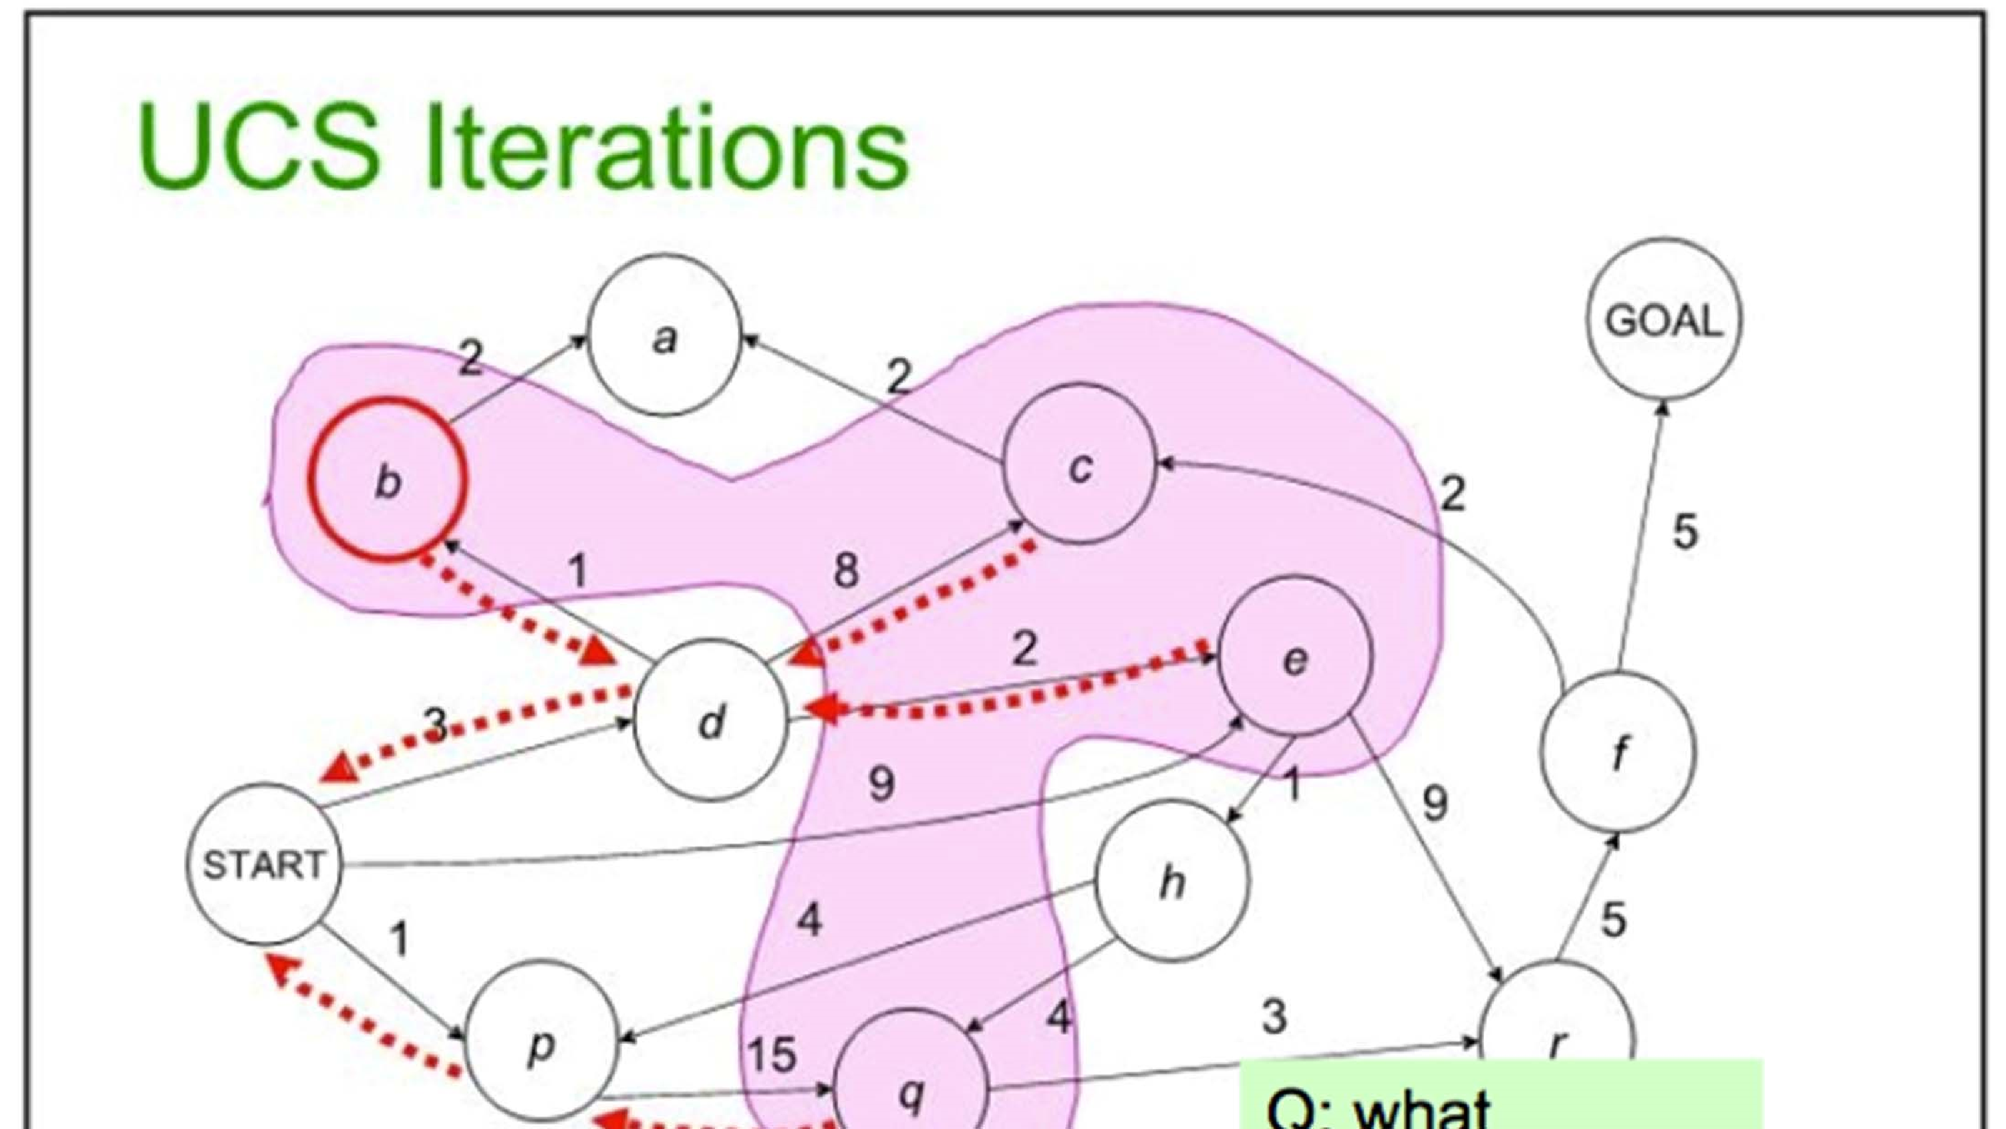
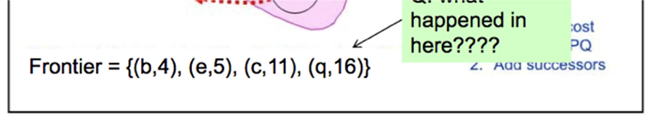

Slide 82
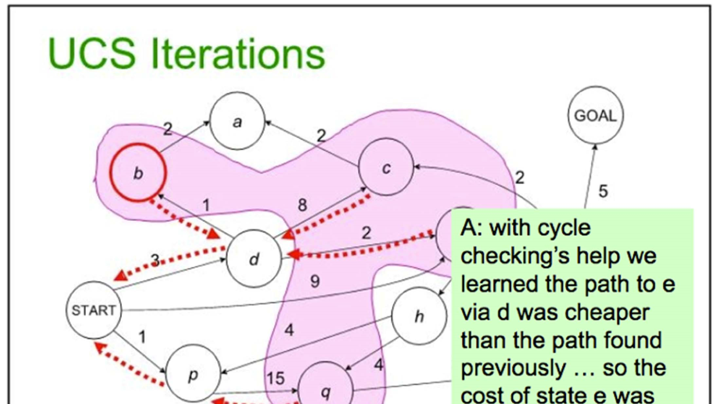
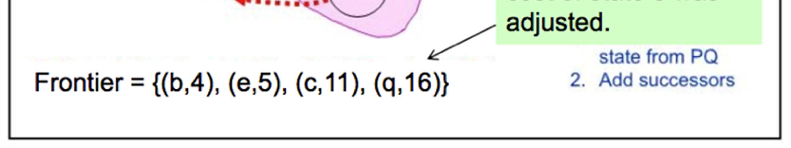

Slide 83
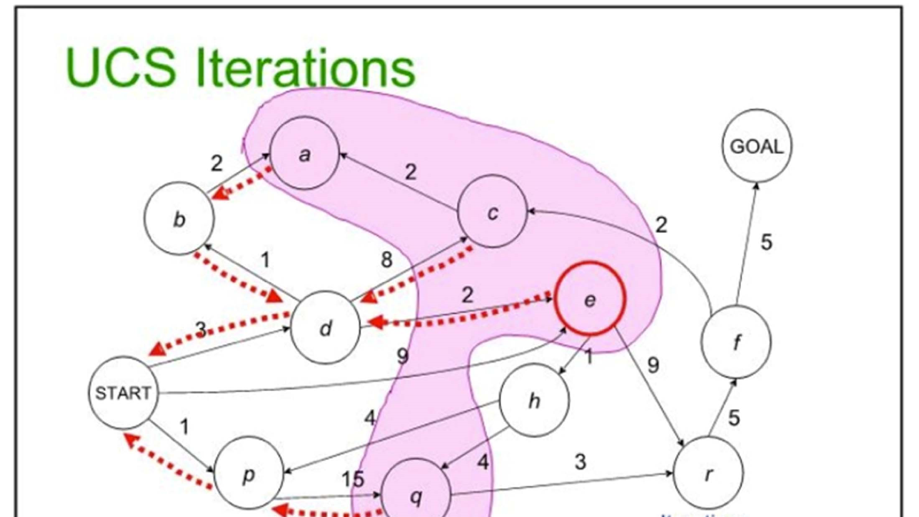
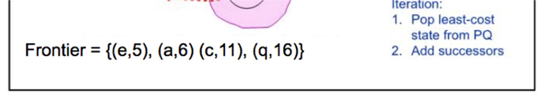

Slide 84
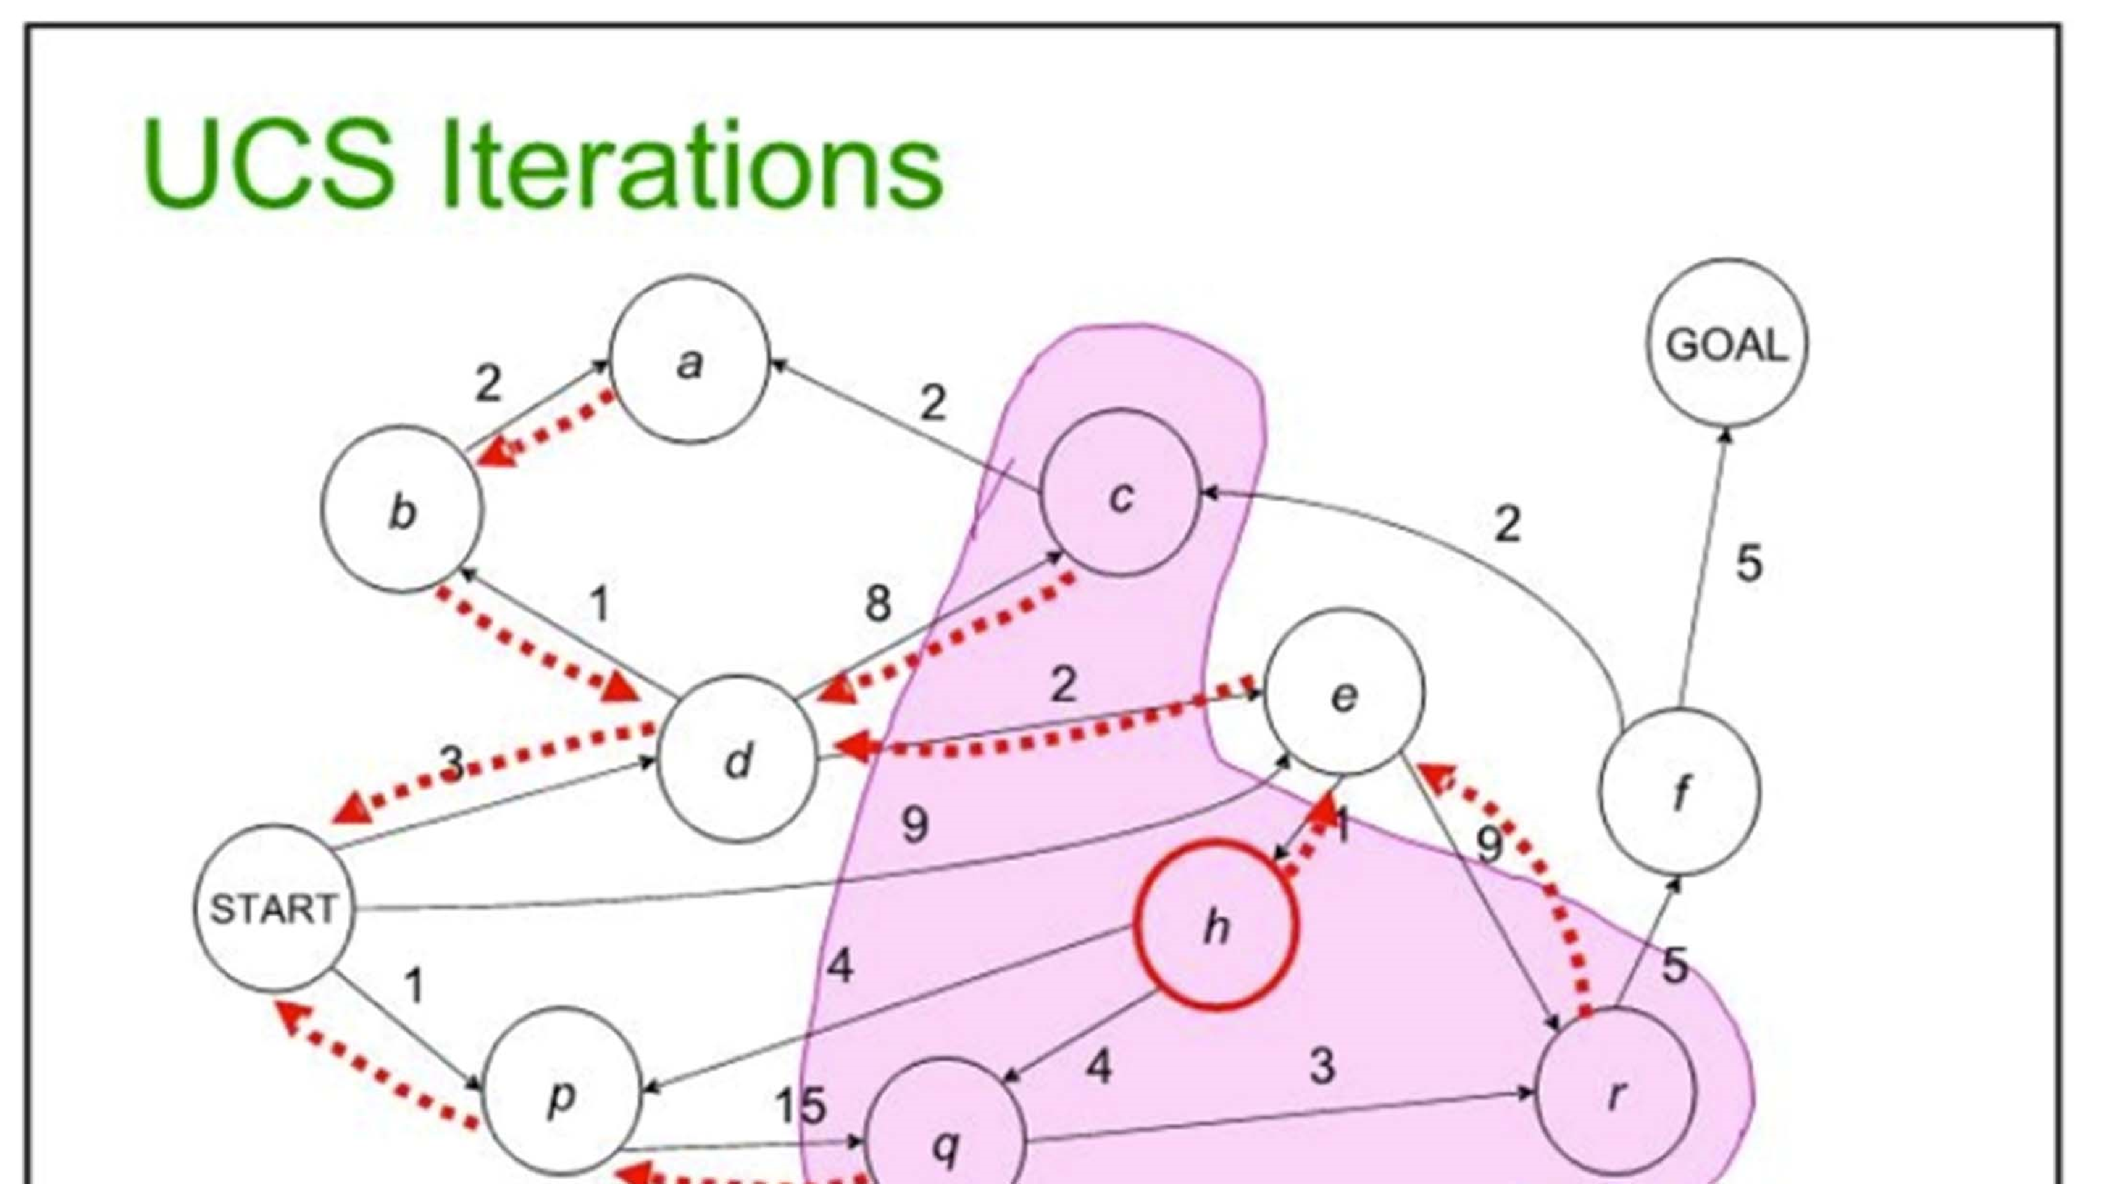
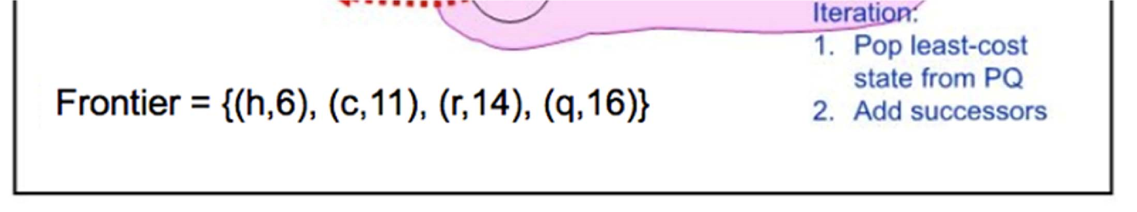

Slide 85
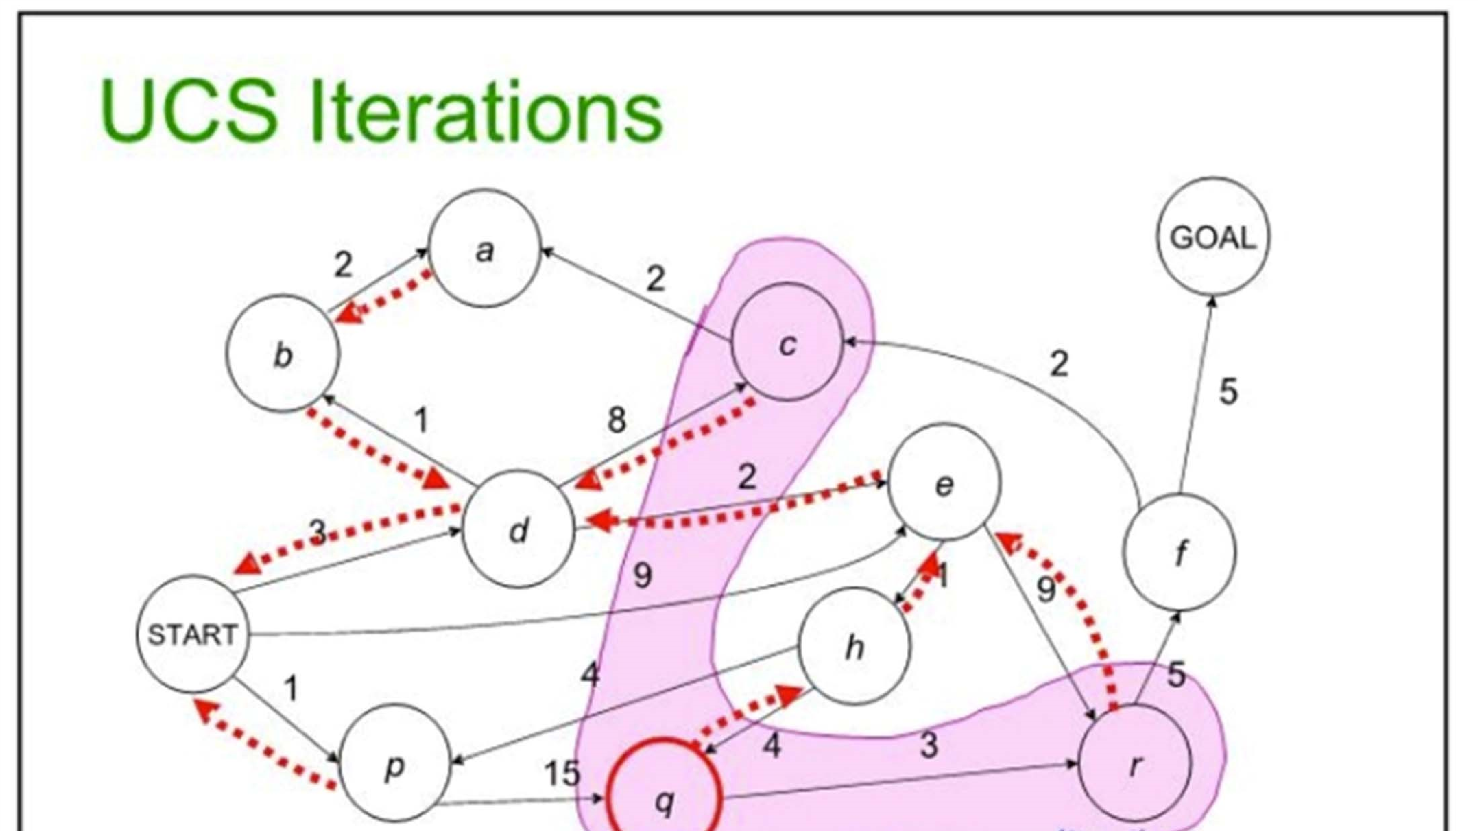
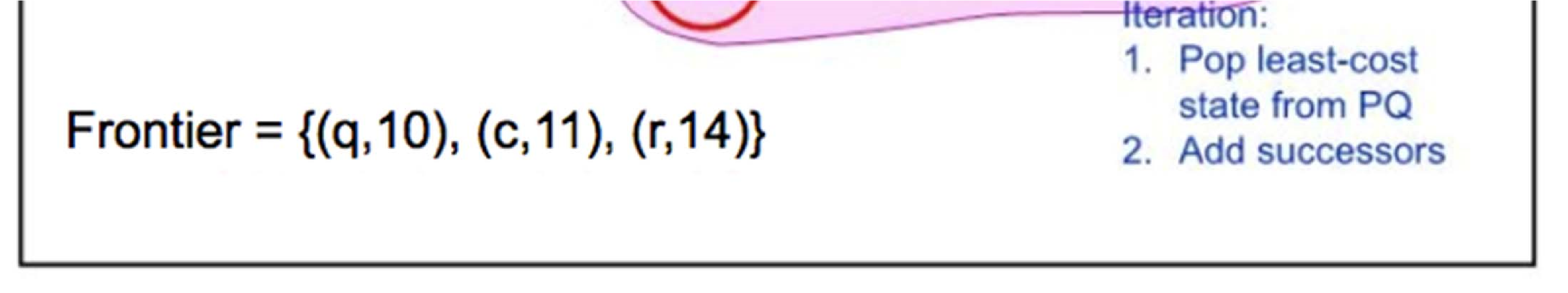

Slide 86
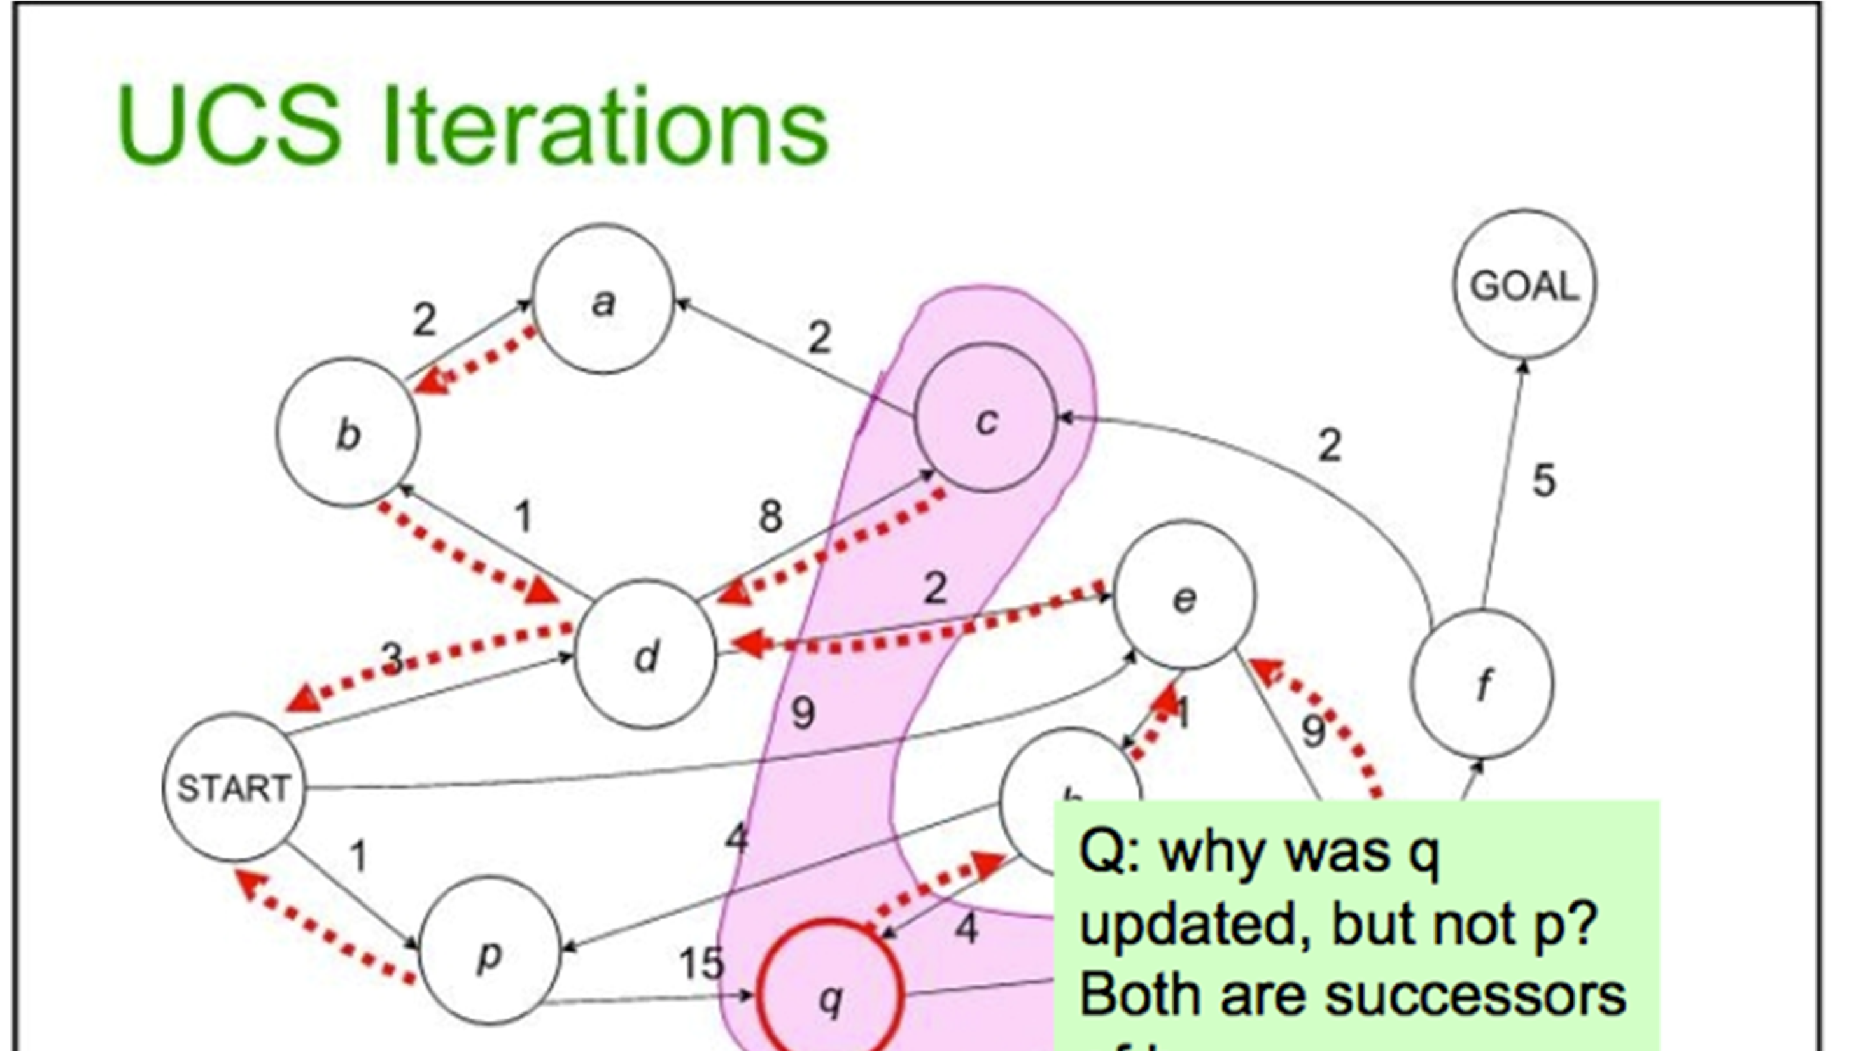
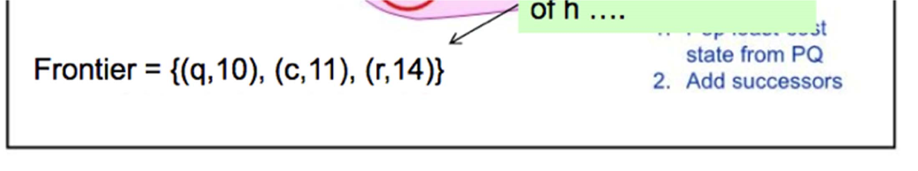

Slide 87
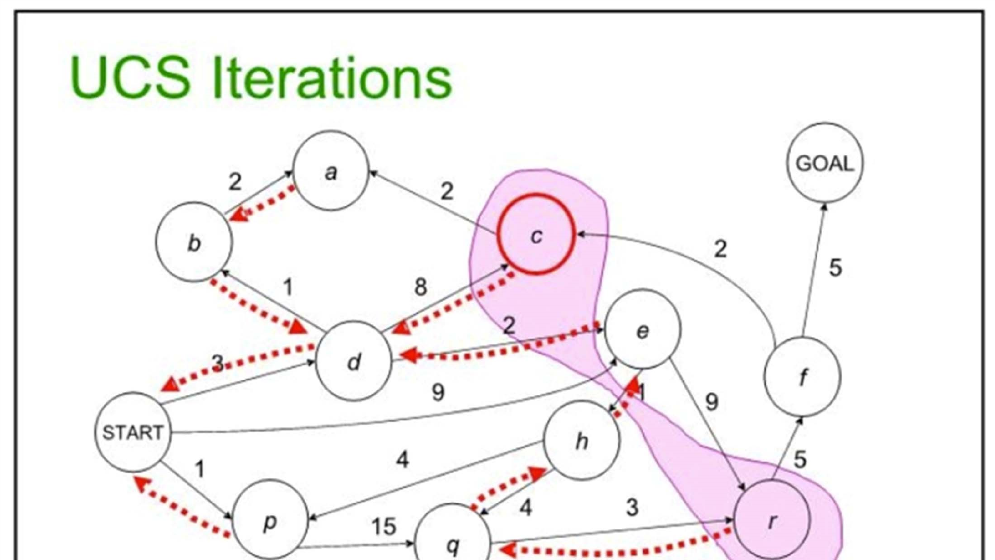
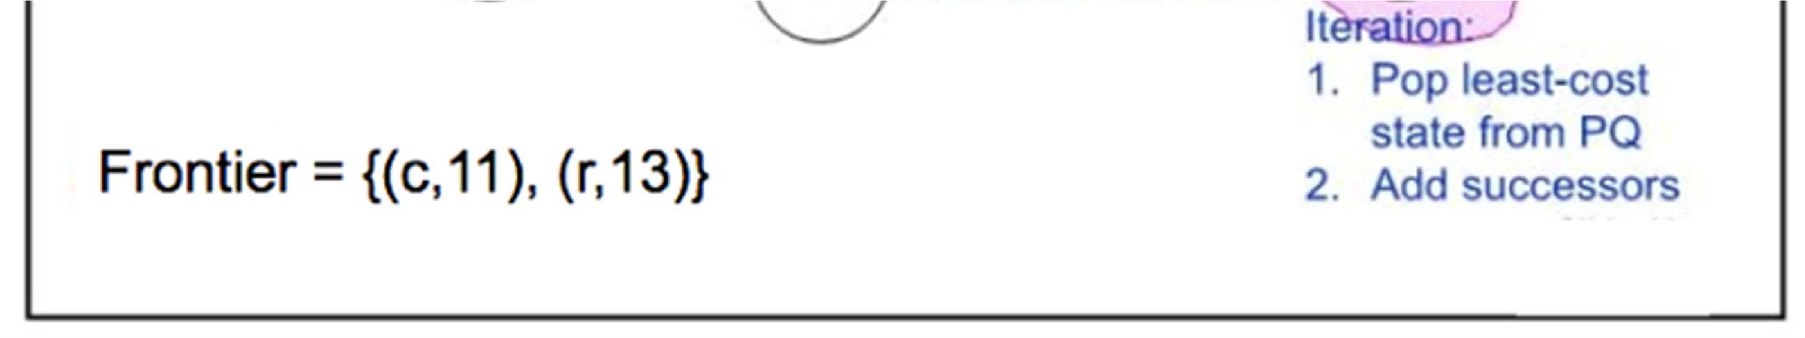

Slide 88
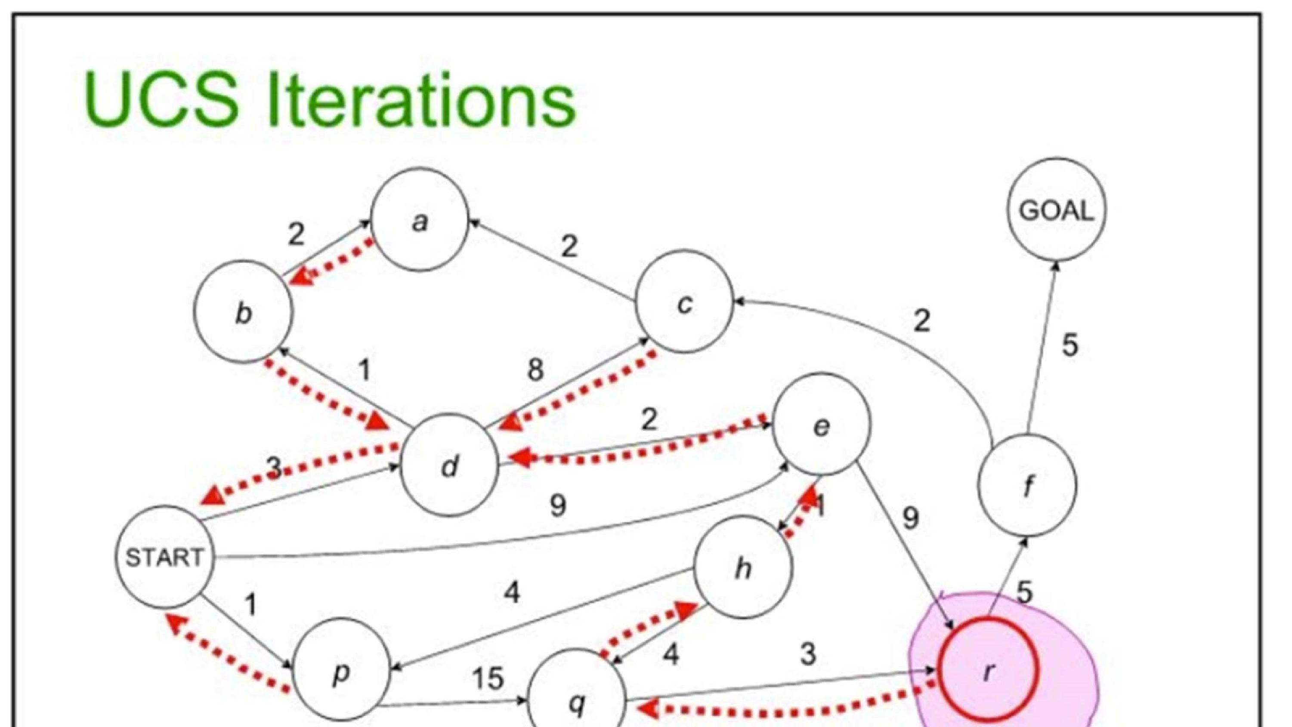
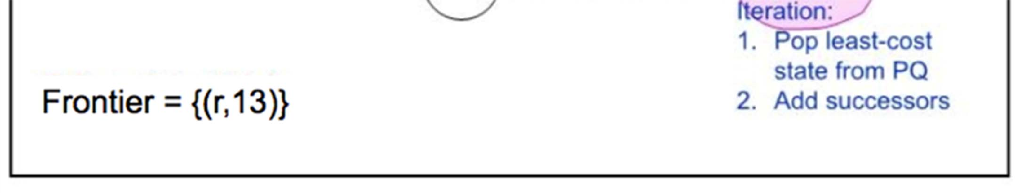

Slide 89
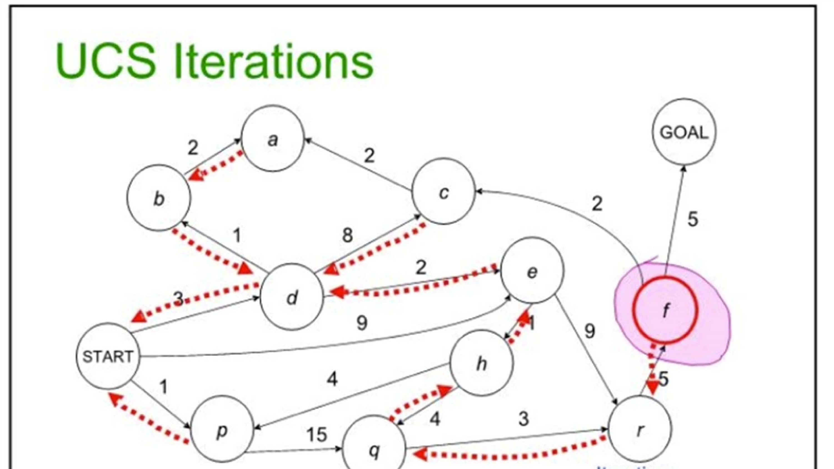
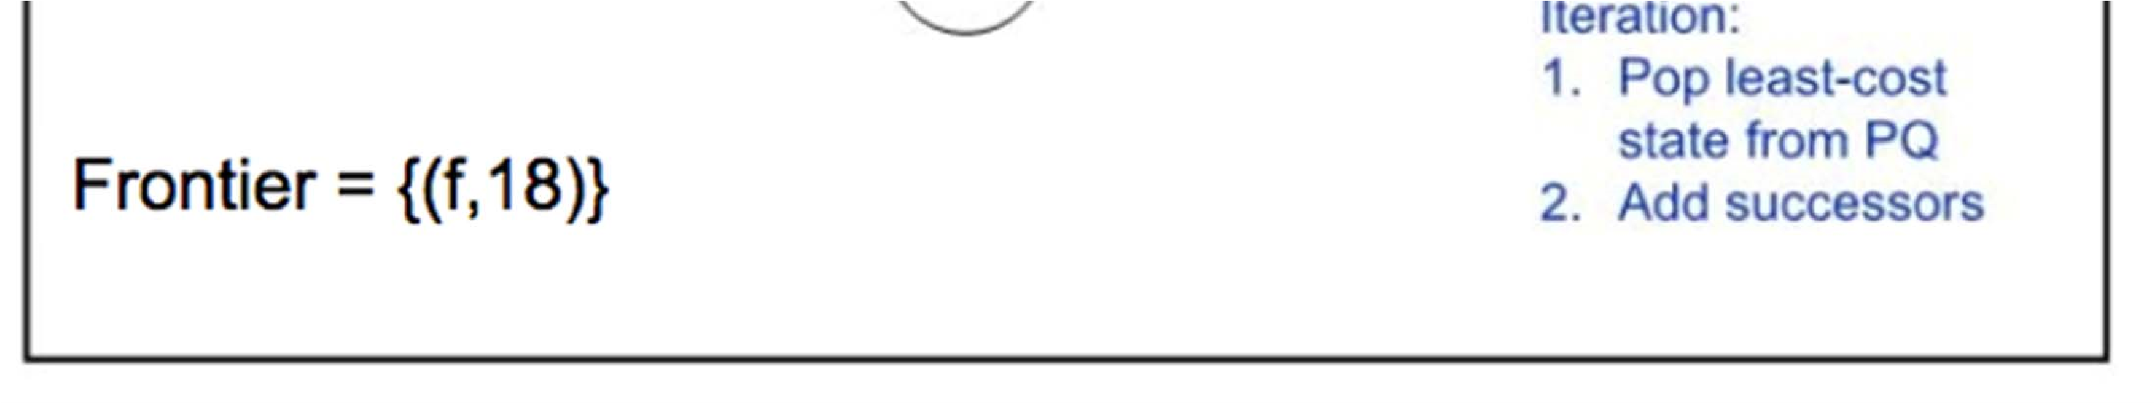

Slide 90
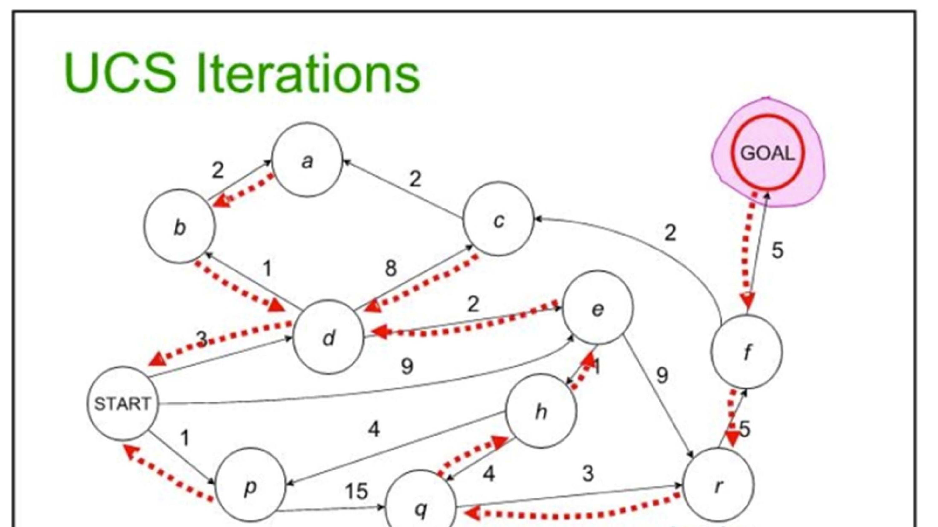
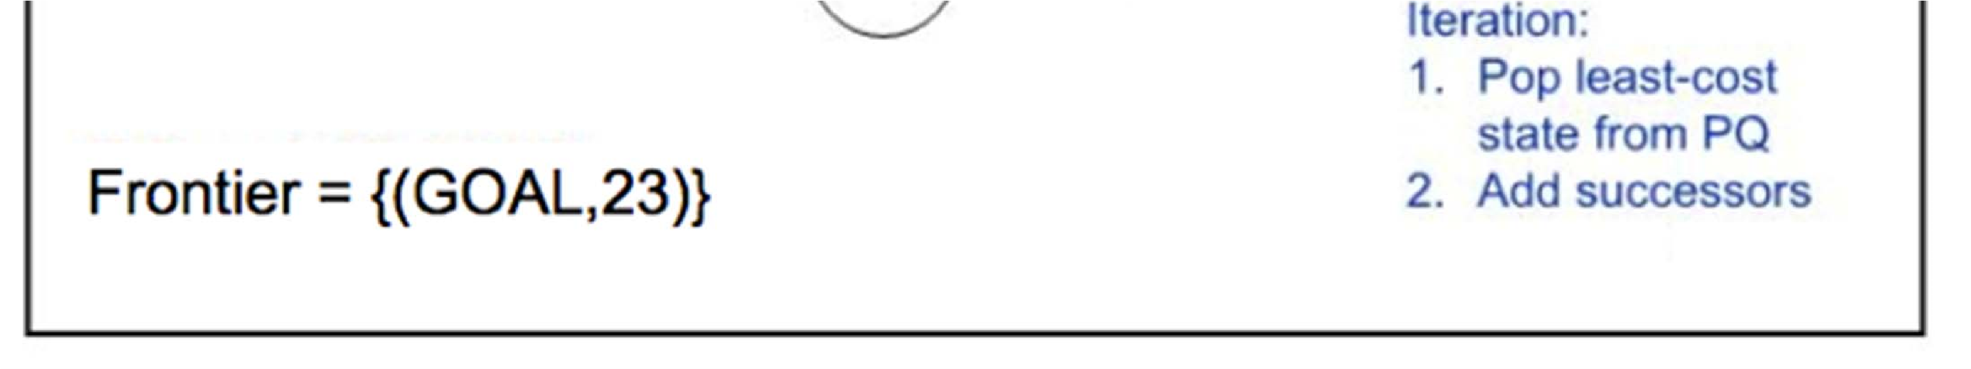

Slide 91
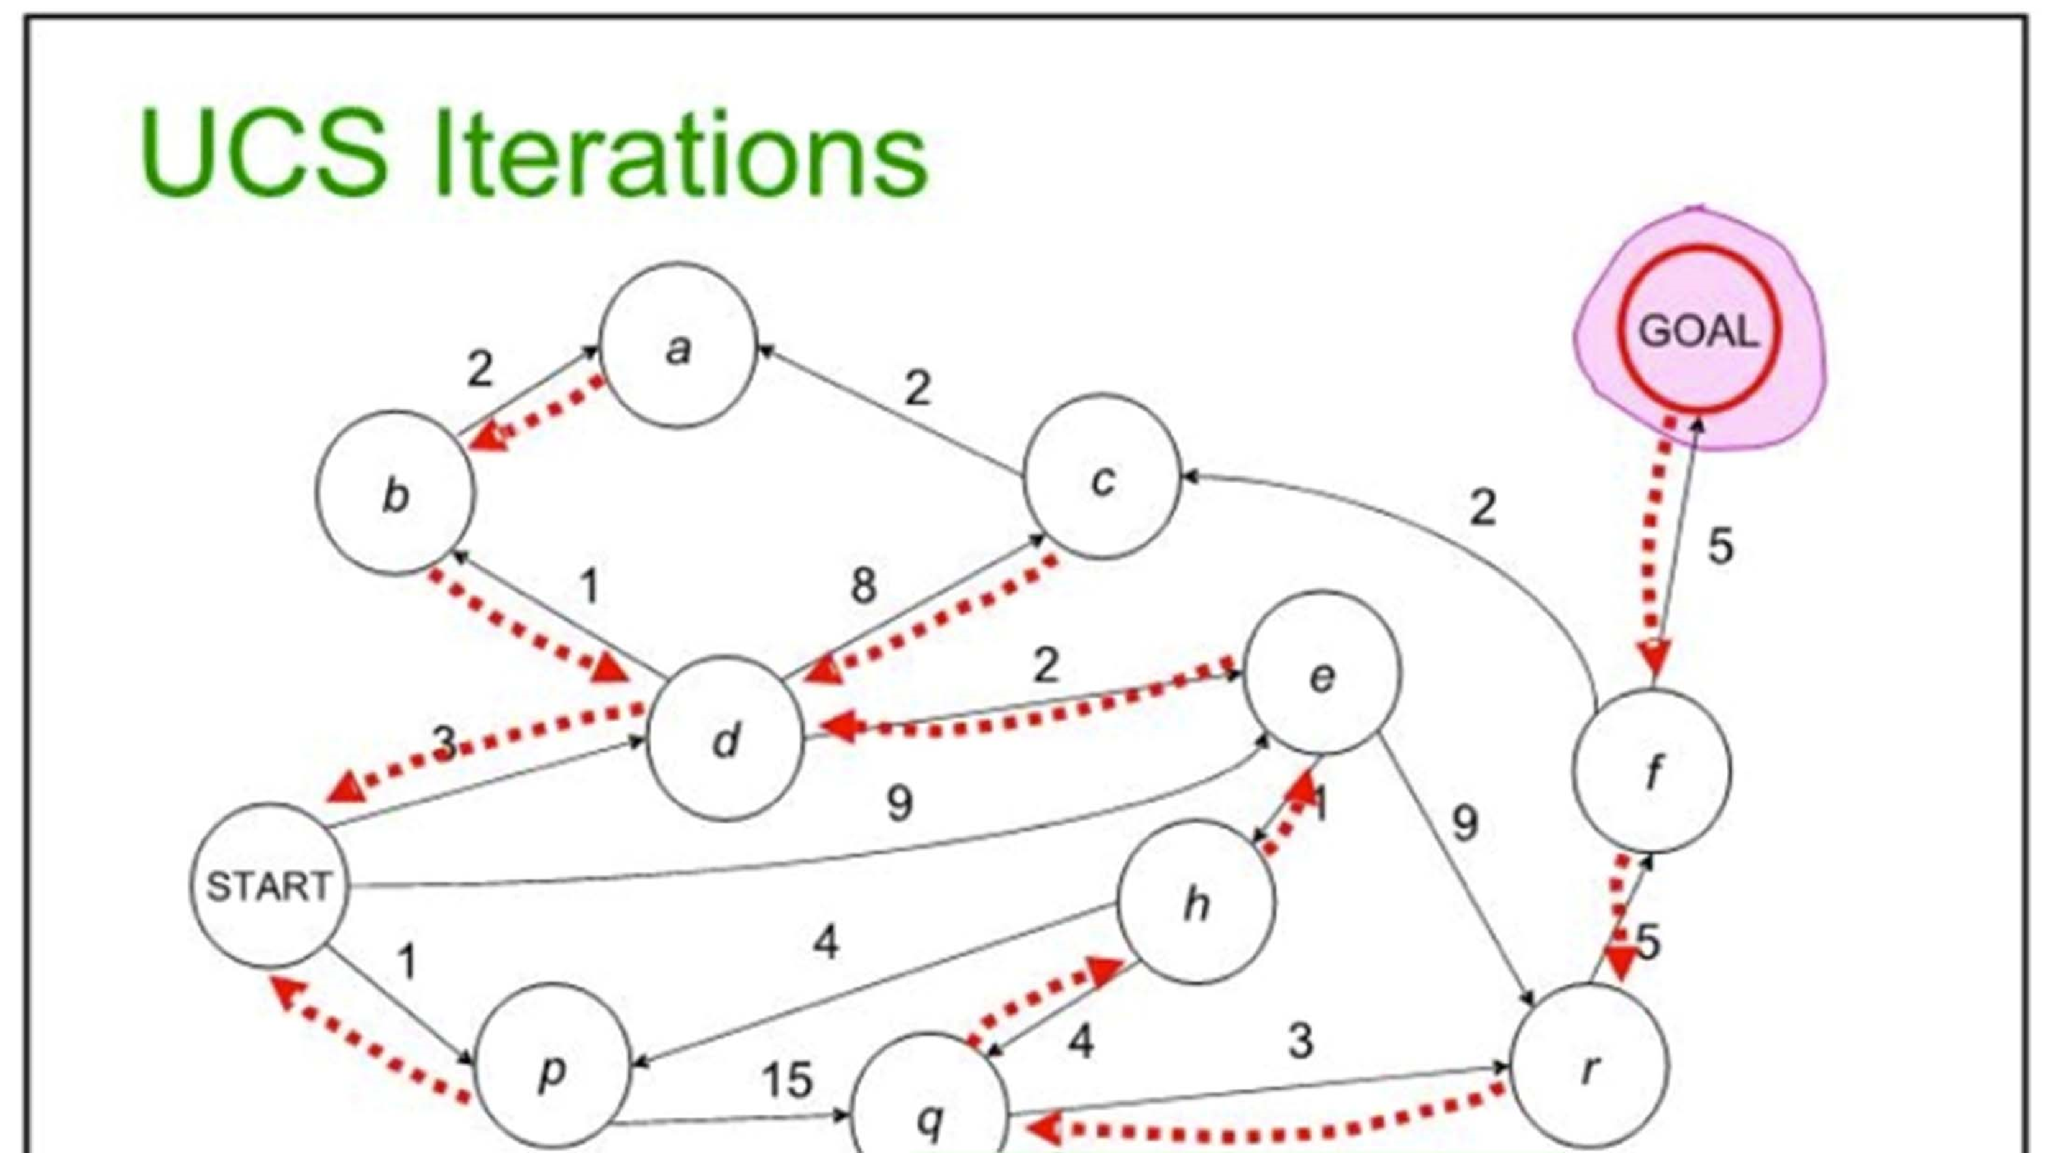
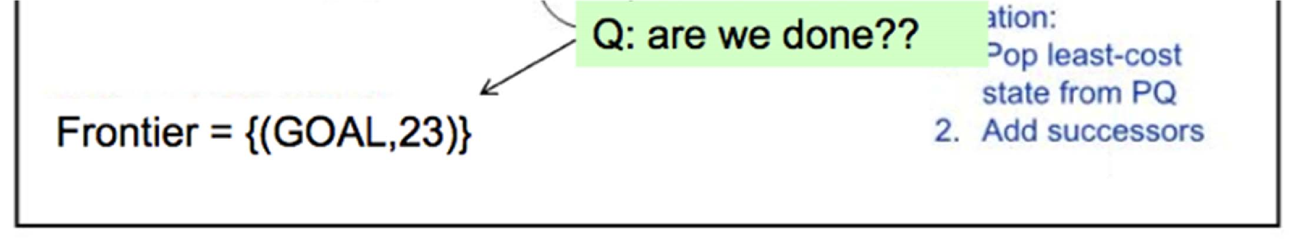

Slide 92
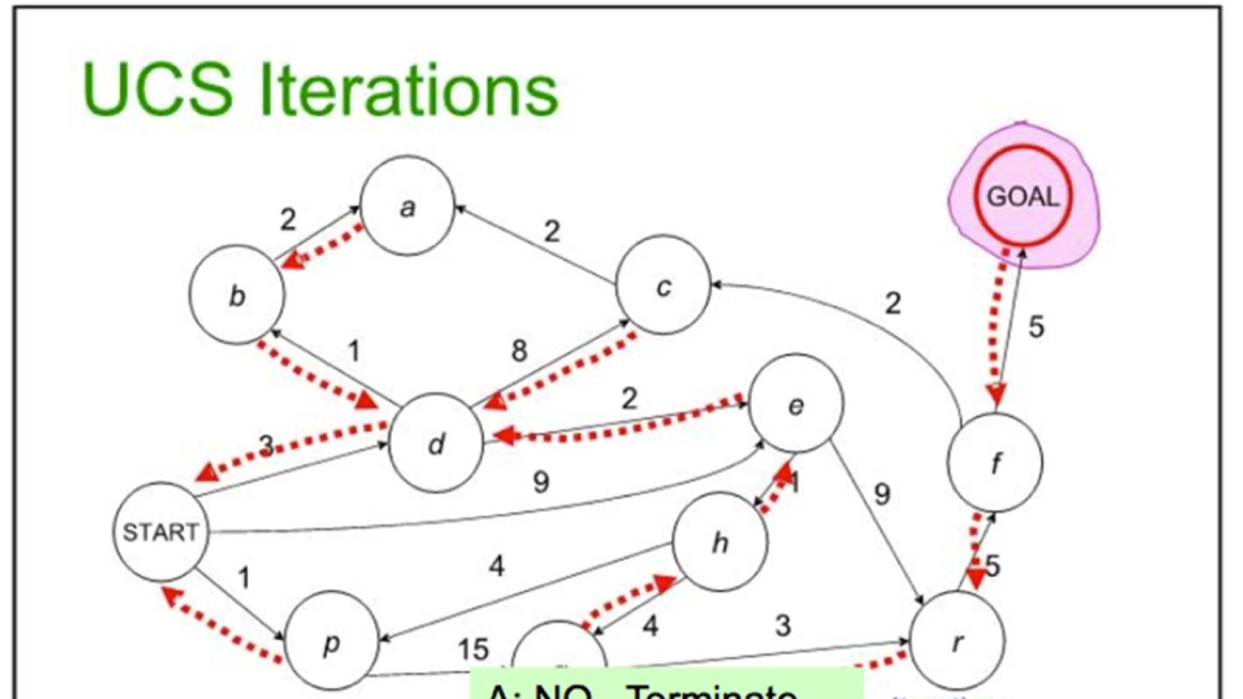
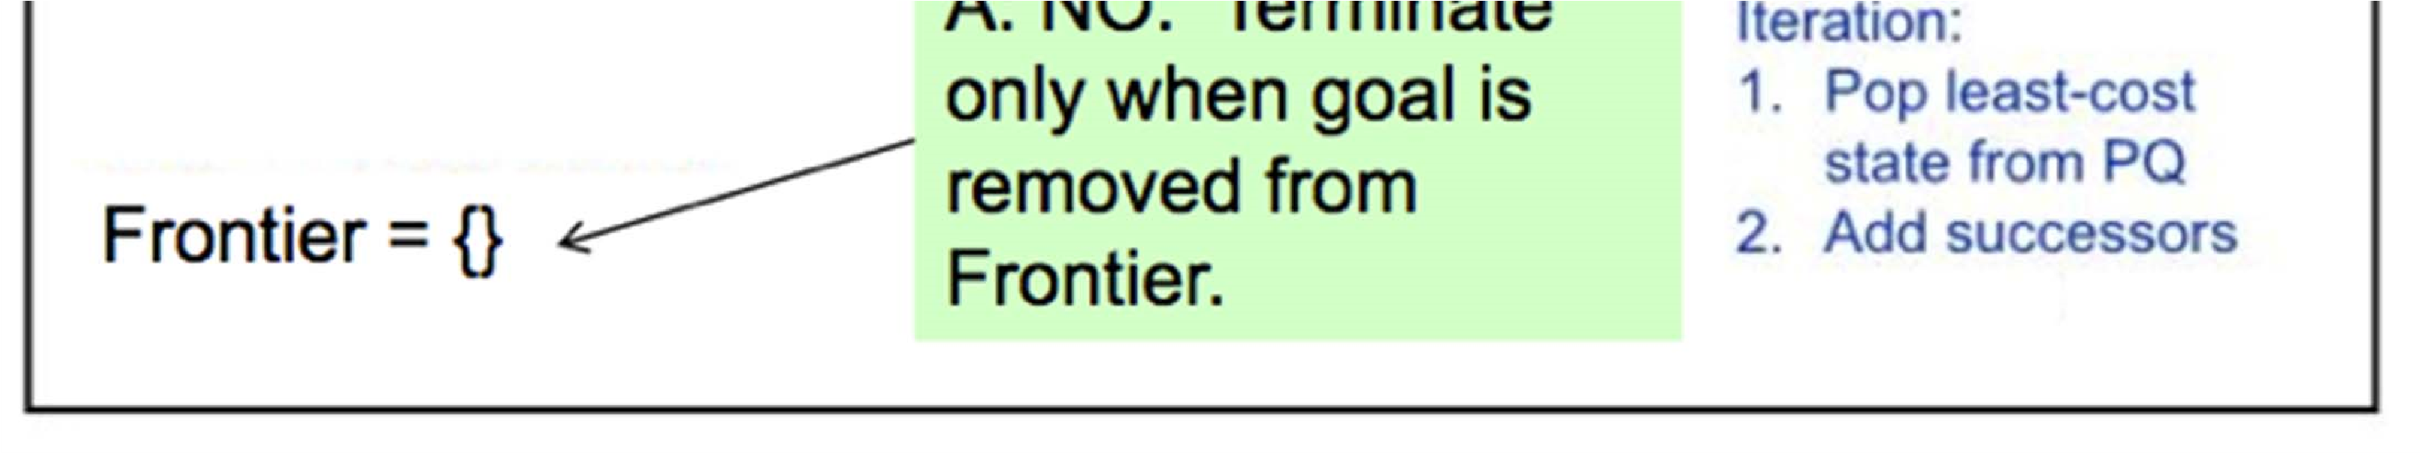

Slide 93
Uniform‐Cost Properties
Optimality?
YES. Let’s prove this. Note that the arguments we see here will be used again when we examine heuristic search.
Is cycle checking required to guarantee an optimal solution?

Slide 94
Uniform‐Cost Properties
Completeness?
YES. Given positive, nonzero transition costs, the previous argument used for breadth first search holds: the cost of the path represented by each node n chosen to be expanded must be non-decreasing.

Slide 95
Uniform‐Cost Properties
Time and Space Complexity?
Assuming each transition cost is ≥ ε > 0.
O(b^{C*/ε + 1}) where C* is the cost of the optimal solution and ε the minimal cost of transitions.
Paths with cost lower than C* can be as long as C* /ε (why not longer?)
There may be many paths with cost ≤ C* ; Uniform Cost Search must explore them all.
We may have b^{C*/ε} paths to explore and expand before finding the optimal cost path.

Slide 96
作业1
在番禺某个区域（地点不能少于20个）旅行的一致代价搜索算法或者迭代加深的深度受限搜索算法，要求：进行环路检查。提示：可以用高德或百度地图API来获取一块地图上的经纬度，注意代价计算采用：曼哈顿距离。
提交内容：（1）提供伪代码算法、（2）讨论考虑环路检查在内的时间复杂度和空间复杂度（要有过程），（3）python或C++程序， 内容(1)-(2)合并用一个word或latex文档, 内容(3)用cpp或py文件。
提交时间：2周内完成，提供电子版作业包，命名规则：AIHW-1-学号-姓名.rar）。

Slide 97
参考文献信息
本课件部分内容的编写参考了如下学者的教材和课件，在此感谢原著者。
朱福喜，
Stuart J. Russell,
Sheila McIlraith
Faheim Bacchus
Sheila McIlraith
Andrew Moore
Hojjat Ghaderi
Craig Boutillier
Jurgen Strum
Shaul Markovitch

